Slide 1
AccessArt EYFS Exemplar Plan
What Are the Aims of the EYFS Exemplar Plan?
Using & Developing the Plan in your School
Areas of Focus

Slide 2
Main Curriculum Pages
Aims of the AccessArt EYFS Exemplar Plan
Over 3000 schools use our resources to help support teaching art in primary school.
This powerpoint shares examples of how AccessArt resources can help support providers of EYFS education.
Our aim is to help nurture an exploratory attitude towards creativity which children can take with them as they grow.

Slide 3
Main Curriculum Pages
The aims of our approach:
To encourage children and staff to explore creativity in a holistic way
To encourage an open-ended exploration of materials, ideas and techniques.
To encourage children and staff to value the journey over or alongside outcome
To encourage children to explore notions of “identity”, gain the confidence to share their exploration and their thoughts, and to learn to appreciate and respect that others might have different experiences of their own identity.
To encourage children to work together as a team, as well as value their ability to work alone.
To demonstrate that drawing, mark-making, making etc are physical as well as mental activities in which the mind and the body are involved.
To demonstrate that every individual has the power to create and make, to manipulate and contribute to the world, for the enjoyment of their own self and for others.

Slide 4
Main Curriculum Pages
A Word about Progression…
The following resources are presented in areas of Areas of Focus rather than ordered by age or term.
These resources do NOT provide a tick list of skills to be explored and achieved (this is not something AccessArt believes in). Instead we believe children should be introduced to a wide a variety of materials and experiences, which are revisited over time. Confidence in handling materials, exploring techniques and realising ideas builds over time and through repeated experience. There is great benefit in revisiting, repeating, expanding and thinking around the project ideas, as the experience children bring to each activity changes over time.
It is through working closely with individual children that teachers will really understand the types of materials, techniques and ideas that each child responds to, and how they might be helped to explore those areas further.
The examples included are designed to demonstrate to providers of EYFS how an open-ended, child-led approach can help build skills and enjoyment in children so that by the time they enter primary education they have a mindset which will help them become confident, creative learners ready for a more thorough exploration of drawing, making, sketchbooks, painting, printmaking, photography, design and craft.

Slide 5
Main Curriculum Pages
The AccessArt EYFS Exemplar Plan for Art has the following Areas of Focus:
Exploring the Natural World
Being inspired by the world around us
Understanding Identity and Exploring Relationships
Feeling connected
Exploring the Power of Creativity
Making Art

Slide 6
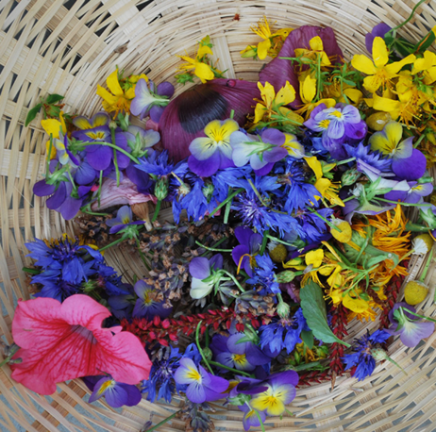
Main EYFS Page
Exploring the Natural World
The resources in this section focus upon how we can facilitate an exploration of the natural world which stimulates creative thinking.
Primal Painting
Feely Drawings (or Drawing by Touch)
To Colour
Dressing Up As A Fossil

Slide 7
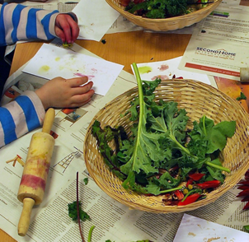
Main EYFS Page > Exploring the Natural World
Primal Painting
The Primal Painting resource shares a session in which children explore nature as a source of natural pigments. Plants are squashed and ground to produce texture and colour with which to make art.
Enables an active exploration of the natural world,
and to making art.
Encourages children to look at the world as a place
containing elements they can manipulate & transform
Develops hand eye coordination and dexterity skills
Opportunity to explore early mark making
Encourages discovery, conversation and sharing
Creates a holistic approach to making art
Adapt:
The session originally took place with 5 and 6 year old children. To adapt to EYFS, you may like to swap some of the tools used and work under closer supervision, for example swap a small hammer for a small handheld stone. Obviously care should be taken to ensure children don’t put the plants in their mouths.
Join AccessArt for full access to over 850 resources

Slide 8
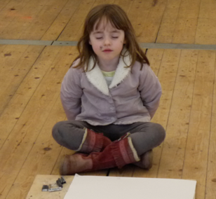
Main EYFS Page > Exploring the Natural World
“Feely Drawings” or Drawing by Touch – a 5 minute drawing exercise
The ”Feely Drawings” resource explores making drawings in response to objects using the sense of touch.
It separates drawing into 2 activities: exploring an object through our sense and then making a drawing of the information we can remember.
Encourages children to explore objects through senses other than sight
Promotes curiosity, thinking, recall & creative decision making
Develops hand eye coordination
Explores mark making as a way to share information
Develops early visual literacy skills (see * below)
Adapt:
Vary the objects which children “sense” by feeling them to suit the age and ability of the child.
*After the drawings are made, develop the activity into a game whereby children can discuss which drawings were inspired by which objects.
Join AccessArt for full access to over 850 resources

Slide 9
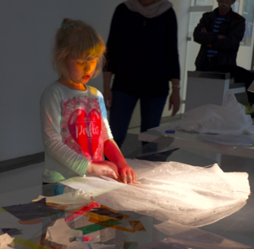
Main EYFS Page > Exploring the Natural World
To Colour…
The To Colour resource shares a session which took place originally with children with Autism. However the gentle and playful exploration of colour, how it makes us feel and how it feeds into other senses is perfect for EYFS.
Encourages playful exploration
Helps children explore sensory perception
Promotes teachers & children to create their own learning pathways
Explores colour as a medium beyond paint
Join AccessArt for full access to over 850 resources

Slide 10
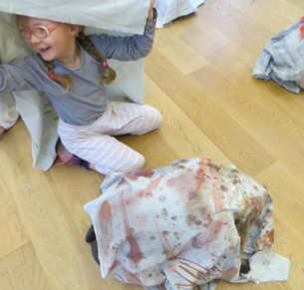
Main EYFS Page > Exploring the Natural World
Dressing Up As Fossils
The ”Dressing Up As Fossils” resource encourages children to observe objects, and then feel enabled to make a creative response to that object. A surprise at the end (using the artwork as a dress up!) makes it a fun and dynamic project!
Develops observation skills
Develops mark making, drawing and painting skills
Demonstrates how different art forms can feed into each other
Promotes group work
Adapt:
The session was originally run with reception/Yr1/Yr2. Consider enabling the children to work in small groups on their pieces of fabric, or even working a parent / helper.
Join AccessArt for full access to over 850 resources

Slide 11
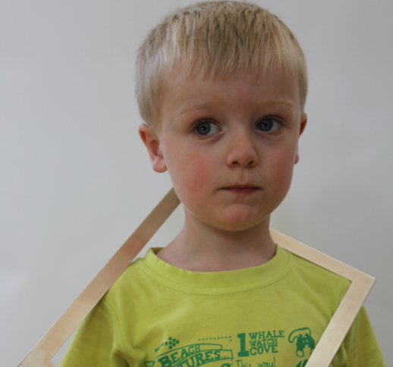
Main EYFS Page
Understanding Identity and Exploring Relationships
Resources to help children explore who they are, and how they might connect to those around them.
Making Finger Puppets
Self Portraiture Photography

Slide 12
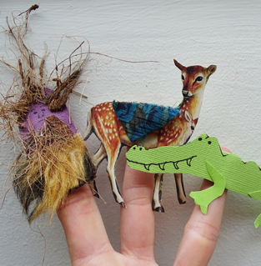
Main EYFS Page > Understanding Identity and Exploring Relationships
Making Finger Puppets
The ”Making Finger Puppets” resource was originally created as part of a wellbeing project in collaboration with Mind*.
This resources shares simple ways to make finger puppets which children can make their own. The finished puppets can be used to share stories, act out dialogue and explore drama.
*You do not need to sign up to the Get Arty project to use this resource
Develops dexterity and making skills
Explores using drawing, colouring and collage
Promotes conversations about character and identity
Promotes ideas about story, narrative and dialogue
Enables children to work alone and then contribute their work to shared experience
Adapt:
The resource shares 3 ways to make finger puppets, from a simple template which staff can cut out, to a more complex Modroc version. An easy resource to adapt to different ages and abilities.
Join AccessArt for full access to over 850 resources

Slide 13
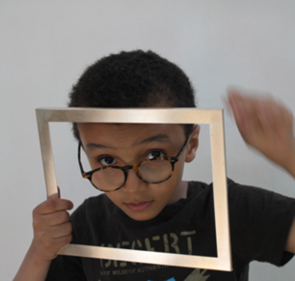
Main EYFS Page > Understanding Identity and Exploring Relationships
Self Portraiture Photography
The ”Self Portrait Photography” resource is an exciting way to explore self portraits.
Children have the opportunity to use props and personal belongings to help explore their sense of self.
Photographs are then developed through drawing and college.
Helps children explore their sense of self, likes & dislikes, personality etc
Explores and connects drama, photography, drawing, collage…
Promotes sharing and conversation
Encourages children to recognize and appreciate the things we have in common and the things which make us special
Join AccessArt for full access to over 850 resources

Slide 14
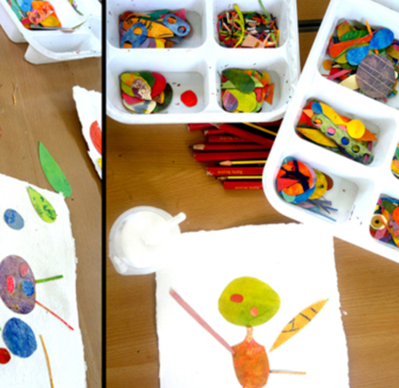
Main EYFS Page
Exploring the Power of Creativity
How do we make Art? And hoes does it make us feel?
Drawing Like a Caveman
Drawing Spirals
Drawing Spiral Snails
Ducklings
Autumn Resist Wax Leaves
Nursery Night Time Collage
Plastacine Printmaking
Painting the Savanna
Marbling
Minibeast Art Work
Wildflower Meadows
Painting with Plastacine
Drawing by Torchlight
Newspaper Heads
Finger Pallete Portraits
Murals in Schools

Slide 15
Main EYFS Page > Exploring the Power of Creativity
Drawing Like a Caveman
The ”Drawing Like a Caveman” resource explores how children can make a variety of marks using their hands and charcoal.
Children find this activity empowering and nurtures a sense of discovery.
Exploration of mark making as it relates to the body
Develops hand eye coordination
Explores right and left hand drawing
Links drawing to history (cave painting)
Join AccessArt for full access to over 850 resources

Slide 16
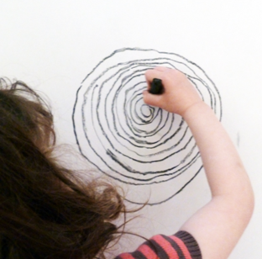
Main EYFS Page > Exploring the Power of Creativity
Drawing Spirals
The ”Drawing Spirals” resource is a simple but effective way of encouraging children to understand that drawing can involve their whole body.
Chunky drawing tools help children make drawings which, though simple, require concentration and express personality.
Exploration of drawing as a physical activity
Develops hand eye coordination
Explores drawing and speed
Links drawing to wellbeing
Adapt:
Use any chunky drawing material for this activity. Whilst encouraging children to draw deliberately in making the spiral, don’t judge results on their being “neat”. All children will make different types of spirals, just like children have different handwriting. Make sure this activity is about encouraging what their spiral will be, not a right or wrong result.
You might like to explore making spirals to music.
Join AccessArt for full access to over 850 resources

Slide 17
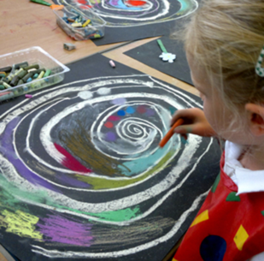
Main EYFS Page > Exploring the Power of Creativity
Drawing Spiral Snails
The ”Drawing Spiral Snails” resource build on from the drawing spiral resource on the last slide.
In this exploration, children use chalk or soft pastel working on white or black paper to explore colour mixing and mark making.
Explores drawing and colour mixing as a tactile activity
Develops understanding of colour mixing on page
Explores mark making and pattern
Join AccessArt for full access to over 850 resources

Slide 18
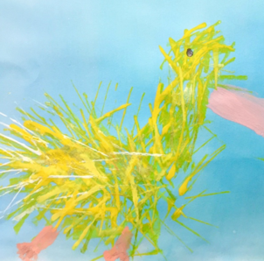
Main EYFS Page > Exploring the Power of Creativity
Ducklings
The “Ducklings” resource shares a way to introduce children to printmaking and enables them to explore how we might create a feeling of “form” and texture on the page.
Promotes close looking
Explores printmaking as a tool for mark making
Explores ideas about “shape” and how we can make “shapes”
Join AccessArt for full access to over 850 resources

Slide 19
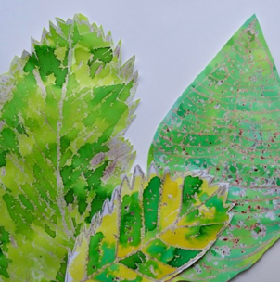
Main EYFS Page > Exploring the Power of Creativity
Wax Resist Autumn Leaves
Introduce children to the magic of creating invisible wax lines which are then made to appear on the page with watercolour in the ”Wax Resist Autumn Leaves”.
Use the leaves made by individuals towards a larger shared collage project.
Promotes mark making skills
Promotes close looking followed by experimentation
Enables an exploration of colour
Promotes individual and group ways of working
Adapt:
You may wish to miss out the first drawing exercise and instead move straight on to using wax. Work on large sheets of sugar paper so children can use chunky wax crayons with control. Brusho can be messy so you might like to replace with watered down post paint.
Adults can help cut leaves out though older or more able EYFS children will enjoy the cutting practice.
Join AccessArt for full access to over 850 resources

Slide 20
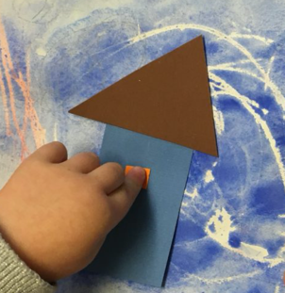
Main EYFS Page > Exploring the Power of Creativity
Nursery Night Time Collage
Explore wax resist and collage with the “Nursery Night Time College” resource.
Combines mark making, painting, colour and collage
Develops fine motor skills
Promotes conversations about place, night / day, dark / light
Join AccessArt for full access to over 850 resources

Slide 21
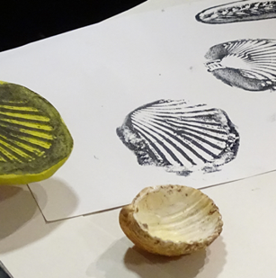
Main EYFS Page > Exploring the Power of Creativity
Plastacine Printmaking
The “Plastacine Printmaking” resource shares a very simple way to make prints.
Use this method to help children explore the natural world and create their own marks and patterns. The finished prints can be used as collage elements in other artwork.
Explores printmaking
Develops understanding of negative and positive prints
Join AccessArt for full access to over 850 resources

Slide 22
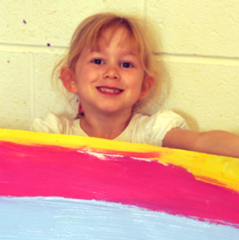
Main EYFS Page > Exploring the Power of Creativity
Painting the Savannah
In the ”Painting the Savannah”
children have the opportunity to work collaboratively to make backgrounds for their artwork, and then work individually to create animals to college onto the paper.
Lots of exciting stages keep children’s attention and contribute to an understanding as to how we can build imagery.
Promotes a range of skills including mono printing, drawing, colour mixing, painting, stencils, collage and scale.
Promotes collaborative working
Develops fine motor skills through active and physical sessions
Join AccessArt for full access to over 850 resources

Slide 23
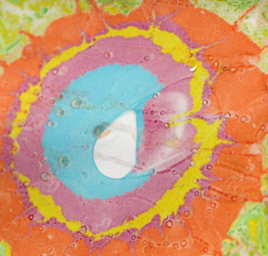
Main EYFS Page > Exploring the Power of Creativity
Marbling
Create patterned paper with the “Marbling” resource.
Children love the element of surprise when marbling. Work in very small groups.
Explores reactions of pigments on water
Inspires experimentation and promotes curiosity
Creates sheets which can standalone or be used for other projects
Join AccessArt for full access to over 850 resources

Slide 24
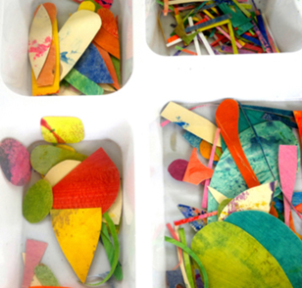
Main EYFS Page > Exploring the Power of Creativity
Minibeast Artwork
The “Minibeast Artwork” resource enables children to undertake a fun exploration of minibeasts, inspired by the natural world and into a fantasy one!
Explores colour, shape and narrative
Develops fine motor skills
Promotes close looking followed by developing individual creative response
Adapt:
Children will enjoy painting the sheets but adults might want to help cut shapes (with children enjoying sorting the shapes). Swap acrylic paint for poster paint.
Join AccessArt for full access to over 850 resources

Slide 25
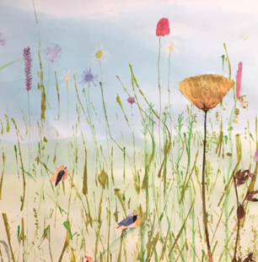
Main EYFS Page > Exploring the Power of Creativity
Wildflower Meadow
Make shared artwork with the “Wildflower Meadow” resource. Children learn how to make large colour washes, print with card, and draw and collage wildlife to create beautiful atmospheric imagery.
Explores different ways to use paint
Explores printmaking
Develops drawing, cutting and collage skills
Promotes individual and collaborative working
Join AccessArt for full access to over 850 resources

Slide 26
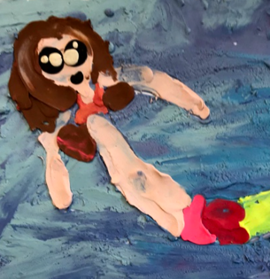
Main EYFS Page > Exploring the Power of Creativity
Painting with Plastacine
A great way to explore colour mixing and develop fine motor skills – the “Painting with Plastacine” resource enables children to create small images in “relief”.
Explores an innovative approach to create 3d painting
Explores ideas about foreground and background
Explores colour mixing
Develops fine motor skills
Join AccessArt for full access to over 850 resources

Slide 27
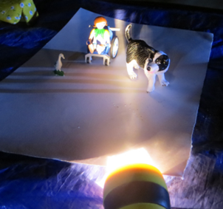
Main EYFS Page > Exploring the Power of Creativity
Drawing by Torchlight
The “Drawing by Torchlight” resource develops skills in using charcoal and exploring light and dark.
Using children’s toys and torchlight makes the drawing process exciting and relevant.
Develops looking skills
Encourages children to make links between drawing, play and narrative
Explores light and dark and mark making
Adapt:
Use small boxes on their side to create mini “theatres” and shine the torch on the contents.
Join AccessArt for full access to over 850 resources

Slide 28
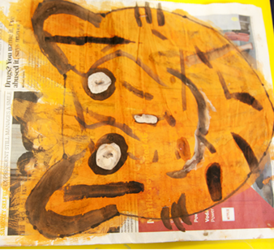
Main EYFS Page > Exploring the Power of Creativity
Newspaper Heads
The “Newspaper Heads” resource shows how to make 3d painted head of whatever you wish! Link it to projects about animals, portraiture, fantasy or drama.
Explores colour and mark making
Develops 3d experience
Links to drama and storytelling
Join AccessArt for full access to over 850 resources

Slide 29
Main EYFS Page > Exploring the Power of Creativity
Finger Pallete Portraits
The ”Finger Palette Portrait” resource explores making a drawing of your partner using charcoal.
Encourages looking
Explores how to share what you see through drawing
Demonstrates to children that different medium and techniques have different outcomes
Enables individuals to work alone but as part of a team
Adapt:
Charcoal is used in this resource. Whilst charcoal is a great (messy!!) medium for children, you might also want to explore the same process using poster paint.
Encourage children to keep looking at their partner – it’s very easy for children to forget and to only look at their artwork!
Join AccessArt for full access to over 850 resources

Slide 30
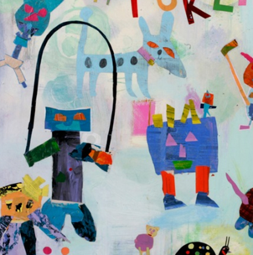
Main EYFS Page > Exploring the Power of Creativity
Murals in Schools
The “Murals in Schools” resource shares how an artist worked with children to create a mural for a wall.
The process described can be used to make less permanent artwork, and enables an exploration of colour, shape and narrative.
Explores colour, shape and narrative
Develops fine motor skills
Promotes individual and collaborative working
Adapt:
Use small boxes on their side to create mini “theatres” and shine the torch on the contents.
Join AccessArt for full access to over 850 resources

Slide 31
Main Curriculum Pages
Accessing the Resources
The AccessArt website currently contains over 850 resources, many of which can be adapted to suit EYFS. Our collection of resources are growing all the time and we will add more to this powerpoint so do check back at www.accessart.org.uk to see the latest version.
Many of the resources are free to access, others are behind the membership wall.
AccessArt is a UK charity (1105049) which aims to inspire and enable high quality visual arts teaching and learning. We receive no core or revenue funding, instead we rely on income from membership to continue to develop our activities. AccessArt has over 8000 subscribers and is trusted by schools across the country to help develop their teaching and learning.
Membership (and access to all resources), starts at just £42 per year.

