Slide 1
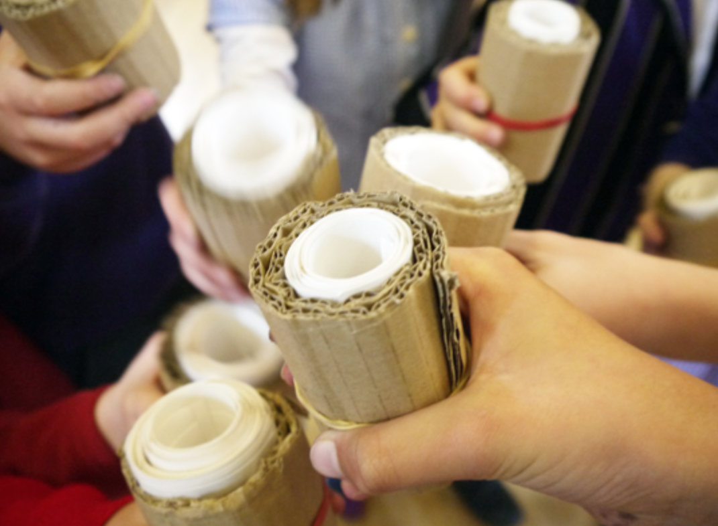
Welcome to the AccessArt
Progression Plan for Primary Art 2020
Covering:
Generating Ideas
Making
Evaluation
Knowledge & Understanding
Assessment Questions
Find further information relating to the AccessArt Progression Plan for Primary Art here.
The plan has been created by Paula Briggs and Sheila Ceccarelli of AccessArt. We gratefully acknowledge the expertise of Susan Coles, Paul Carney and Mandy Barret. We also acknowledge that we have taken and built upon some of the end of year descriptors from the NSEAD Curriculum document 2014.
www.accessart.org.uk

Slide 2
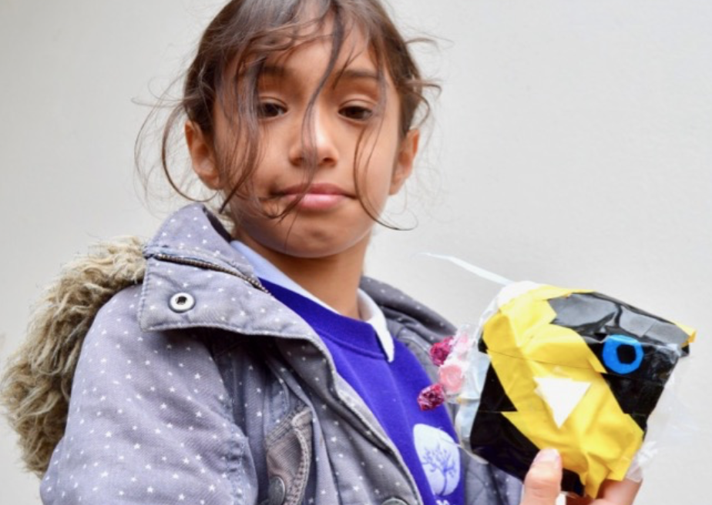
Important Information
We believe the curriculum we present via our Exemplar Plans, and our working methods shared via our Progression Plan, provide schools with a way to access a rich art education for pupils, of which schools can be proud.
The curriculum AccessArt shares is based upon our ethos which has developed over many years and which we believe has creative integrity. In the creation of the Progression Plan we have taken the opportunity to present schools with what we believe will be the best possible art education for their pupils, building and enhancing upon what already exists.
Schools should note that the majority of our resources are created by artist-educators. Some but by no means all were created in formal education settings. It is up to teachers to assess on an individual or school community basis if the resources are right for your school, and how they might best be adapted to suit your needs.
All resources cited in both the Exemplar Plans and the Progression Plan are examples only, and there are many more resources in the evolving AccessArt database which may suit your needs better.
AccessArt presents our work to schools in good faith, but we cannot guarantee and are not responsible for the way the approach is received.
www.accessart.org.uk

Slide 3
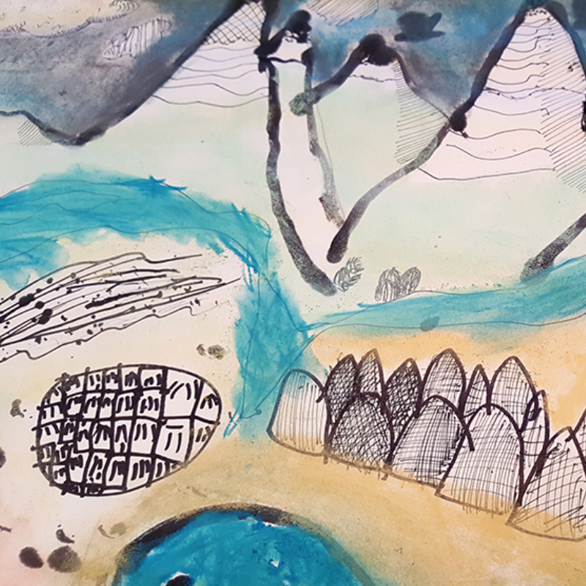
Year 1
www.accessart.org.uk

Slide 4
 | Year 1 – Generating Ideas |  |  |  |  |  | By the end of Year 1 Children should be able to…
Generating Ideas Teachers should: Feel able to model sketchbook use alongside pupils (i.e. keep their own sketchbook) Let pupils discover and share for themselves | Through Sketchbooks |  | By Looking & Talking |  | By Playing |  | Recognise that ideas can be generated through doing as well as thinking Recognise that ideas can be expressed through art Experiment with an open mind
 | Introduce “sketchbook” as being a place to record individual response to the world. Understand some of the activities which might take place in a sketchbook (e.g. drawing, cutting/sticking, collecting). Develop a “sketchbook habit”. Begin to feel a sense of ownership about the sketchbook. |  | Enjoy looking at artwork made by artists, craftspeople, architects and designers, and finding elements which inspire. Be given time and space to engage with the physical world to stimulate a creative response (visiting, seeing, holding, hearing). Develop questions to ask when looking at artworks and /or stimulus: Describe what you can see. Describe what you like? Why? How does it make you feel? What would you like to ask the artist? |  | Generate ideas through playful, hands-on, exploration of materials without being constricted towards a pre-defined outcome.

Slide 5
 | Year 1 - Making |  |  |  | By the end of Year 1 Children should be able to…
Making Teachers should: Balance time in which you sensitively model a technique, with plenty of time for pupils to enjoy open-ended exploration, and project-based learning Have the confidence to celebrate places where pupils diverge from the task (as being signs that they are owning their learning) | Drawing | Painting & Collage | Printmaking | 3D | Try out a range of materials & processes and Recognise they have different qualities Explore materials in a playful and open-ended manner Use materials purposefully to achieve particular characteristics or qualities Be excited by the potential to create. Understand that art is different to many subjects at school: through art, they can invent and discover
 | Begin to explore a variety of drawing materials including pencil, graphite, pen, chalk, soft pastel, wax and charcoal. Please see curriculum planning art Explore mark making to start to build mark-making vocabulary e.g. drawing soft toys and drawing feathers Undertake projects which explore observational drawing (drawing what you see), to record what is seen, and also experimental drawing, to share what is felt. Please see observational and experimental drawing and making magic spells and Woodland Exploration Become familiar with 2 or more drawing exercises repeated over time to build skill. See Drawing Exercises at start here drawing | Recognise primary colours and use an experiential approach to simple colour mixing to discover secondary colours. e.g. exploring colour Benefit from experiences learnt through drawing (in column 1) (mark-making, observational drawing, experimental drawing) and apply these skills to painting and collage: e.g. mark making with acrylic paint and painting a rainbow-forest Enjoy discovering the interplay between materials for example wax and watercolour wax resist autumn leaves | Explore simple printmaking. For example using plasticine, found materials or quick print foam, plasticine printmaking or everyday printmaking Search out found objects to be used as tools to press into plasticine to create texture and to understand notions of positive and negative. Use rollers or the backs of spoon to create pressure to make a print. Explore pattern, line, shape and texture. | Explore, discover and invent ways for 2d to transform into 3d sculpture. This might be through creating drawings or prints on paper which are then folded, through collage which becomes relief, through 2d shapes which are cut out and constructed with. For example making birds Explore modelling materials such as Modroc, clay and plasticine in an open-ended manner, to discover what they might do. modroc plasterboard or making modroc sculpture Use basic tools to help deconstruct (scissors) and then construct (glue sticks).

Slide 6
 | Year 1 - Evaluating |  |  | By the end of Year 1 Children should be able to…
Evaluating Teachers should: Be aware of the importance of sensitively unearthing intention, which may not always be apparent in end result | As a Class | In Small Groups | One to One | Show interest in and describe what they think about the work of others Take pleasure in the work they have created and see that it gives other people pleasure Begin to take photographs and use digital media
 | Enjoy listening to other peoples views about artwork made by others. Feel able to express and share an opinion about the artwork. | Share work to others in small groups, and listen to what they think about what you have made. | Talk to a peer or teacher about the artwork made and share what you have enjoyed during the process, and what you like about the end result.

Slide 7
 | Year 1 – Knowledge & Understanding |  | By the end of Year 1 Children should be able to…
Knowledge & Understanding Teachers should: Recognise that in art, a more valuable and relevant learning experience comes from underpinning technical and formal knowledge with an experiential understanding about what it is to be a creative human. | Formal | Experiential
 | Each child should know: How to recognise and describe some simple characteristics of different kinds of art, craft and design The names of tools, techniques and formal elements (in pink above and below) | Each child should be given the opportunity to: Discover that art is subjective (we all have our own legitimate understanding) Begin to feel confident to express a preference in…. Understand ideas can come through hands-on exploration Begin to build knowledge of what different materials and techniques can offer the creative individual Work at different scales, alone and in groups

Slide 8
 | Year 1 – Vocab & Assessment Questions
Assessment Questions Teachers should consider assessment as a holistic practice, which takes place during every art lesson through conversation with pupils: Tell me about what you are making What might you do next? Tell me about what you have made Remember! “Creativity is a fragile process that is hard to measure and assess and should always be nurtured and supported”

Slide 9
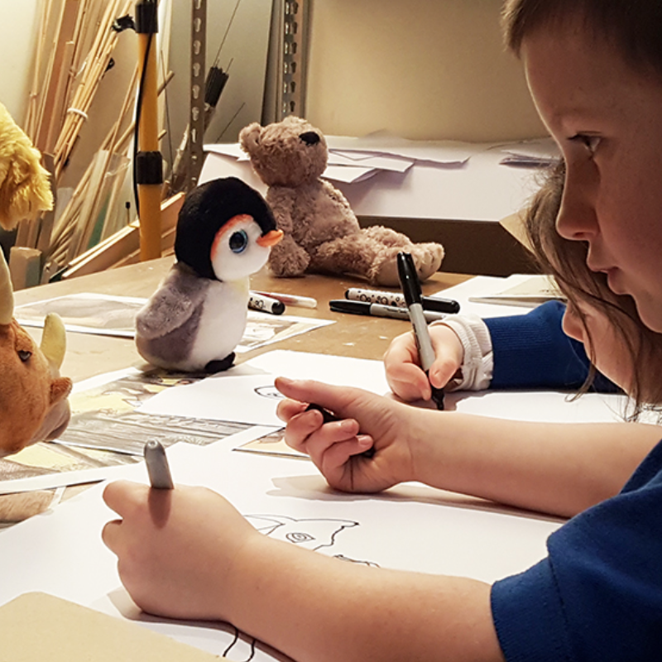
Year 2
www.accessart.org.uk

Slide 10
 | Year 2 – Generating Ideas |  |  | By the end of Year 2 Children should be able to…
Generating Ideas Teachers should: Feel able to model sketchbook use alongside pupils (i.e. keep their own sketchbook) Let pupils discover and share for themselves | Through Sketchbooks | By Looking & Talking | Through Making | Recognise that ideas can be generated through doing as well as thinking Recognise that ideas can be expressed through art Experiment with an open mind Enjoy trying out different activities and make both informed, and intuitive choices about what to do next, letting practical experience feed ideas Use drawing to record and discover ideas and experiences
 | Develop a “sketchbook habit”, using a sketchbook as a place to record individual response to the world. Begin to feel a sense of ownership about the sketchbook. Practice and develop sketchbook use, incorporating the following activities: drawing to discover, drawing to show you have seen, drawing to experiment, collecting, sticking, writing notes… | Enjoy looking at artwork made by artists, craftspeople, architects and designers, and finding elements which inspire. Look at a variety of types of source material and understand the differences: including images on screen, images in books and websites, art work in galleries and objects in museums. Be given time and space to engage with the physical world to stimulate a creative response (visiting, seeing, holding, hearing), including found and manmade objects. Develop questions to ask when looking at artworks and /or stimulus: Describe what you can see. Describe what you like? Why? How does it make you feel? What would you like to ask the artist? | Generate ideas through exploration of materials, building an understanding of what each material can do, how it can be constructed, being open during the process to unexpected ideas.

Slide 11
 | Year 2 Making |  |  |  |  | By the end of Year 2 Children should be able to…
Making Teachers should: Balance time in which you sensitively model a technique, with plenty of time for pupils to enjoy open-ended exploration, and project-based learning Have the confidence to celebrate places where pupils diverge from the task (as being signs that they are owning their learning) | Sketchbooks | Drawing | Painting | Printmaking & Collage | 3D, Architecture & Digital Media | Try out a range of materials & processes and Recognise they have different qualities Use materials purposefully to achieve particular characteristics or qualities Be excited by the potential to create. Understand that art is different to many subjects at school: through art, they can invent and discover Deliberately choose to use particular techniques for a given purpose Develop and exercise some care and control over the range of materials they use
 | Make simple sketchbooks as a way to create ownership from offset making elastic band sketchbooks Explore how to create space and places within the sketchbook to help develop sketchbook approach to include collecting, making drawings on different surfaces, and on different shapes of paper. taking ownership of sketchbooks Continue to familiarize with sketchbook / drawing exercises. Let children describe how to undertake the ones they know as means of recap/reminder and introduce new ones. drawing exercises | Develop mark-making skills through experimentation with various drawing media: pencil, graphite, chalk, soft pastel, wax and charcoal. Guide to drawing materials Explore a variety of drawing starting points (stimuli), including close looking via observation from primary & secondary source material, drawing from memory and imagination. These might include figurative, still life and landscape subject matter for drawings Use drawings as basis for collage minibeast project | Continue to mix colours experientially (i.e. encourage pupils to “try and see”) Revisit colour mixing and understand relationships of primary and secondary colours and apply colour mixing skills to a project e.g Inspired! and exploring colour and paint! Explore painting on different surfaces, such as fabric and different scales dressing up as fossils Use new colour mixing knowledge and transfer it to other media, e.g.soft pastel colour mixing in drawing project or plasticine painting with plasticine | Explore simple mono printing techniques using carbon paper, using observational drawing skills and mark making skills explored through drawing (column 2), and colour mixing skills (column 3) e.g. Monoprinting with oil pastel | Explore how 2d can become 3d though “design through making”. Pls see design in the national curriculum Cut simple shapes from card and use them to construct architectural forms. Use drawn, collaged and printed elements as surface decoration for the architectural maquettes. be an architect Use digital media (film and still photos) to create records of models made, including walk-through videos of the inside of the architectural spaces

Slide 12
 | Year 2 - Evaluating |  |  | By the end of Year 2 Children should be able to…
Evaluating Teachers should: Be aware of the importance of sensitively unearthing intention, which may not always be apparent in end result | As a Class | In Small Groups | One to One | Show interest in and describe what they think about the work of others Take pleasure in the work they have created and see that it gives other people pleasure Understand how evaluating creative work during the process, as well as at the end, helps feed the process. Begin to take photographs and use digital media as a way to re-see work When looking at creative work express clear preferences and give some reasons
 | Enjoy listening to other peoples views about artwork made by others. Feel able to express and share an opinion about the artwork. | Share work to others in small groups, and listen to what they think about what you have made. Take photos of work made so that a record can be kept, to be added to a digital folder/presentation to capture progression. Use documenting the artwork as an opportunity for discussion about how to present work, and a chance for pupils to use digital media. | Talk to a peer or teacher about the artwork made and share what you have enjoyed during the process, and what you like about the end result.

Slide 13
 | Year 2 – Knowledge & Understanding |  | By the end of Year 2 Children should be able to…
Knowledge & Understanding Teachers should: Recognise that in art, a more valuable and relevant learning experience comes from underpinning technical and formal knowledge with an experiential understanding about what it is to be a creative human. | Formal | Experiential
 | Each child should: Know how to Recognise and describe some simple characteristics of different kinds of art, craft and design Know the names of tools, techniques and formal elements (in pink above and below) Know that different forms of creative works are made by artists, craftspeople, and designers from all cultures and times, for different purposes Be able to talk about the materials, techniques and processes they have used, using an appropriate vocabulary | Each child should be given the opportunity to: Discover that art is subjective (we all have our own legitimate understanding) Begin to feel confident to express a preference in…. Experience the connection between brain, hand and eye Understand ideas can come through hands-on exploration Begin to build knowledge of what different materials and techniques can offer the creative individual Work at different scales, alone and in groups

Slide 14
 | Year 2 – Vocab & Assessment Questions | By the end of Year 2 Children should be able to…
Assessment Questions Teachers should consider assessment as a holistic practice, which takes place during every art lesson through conversation with pupils: Tell me about that you are making What might you do next? Which materials might you use? What have you discovered? Tell me about what you have made What would you like to explore more of? Remember! “Creativity is a fragile process that is hard to measure and assess and should always be nurtured and supported”

Slide 15
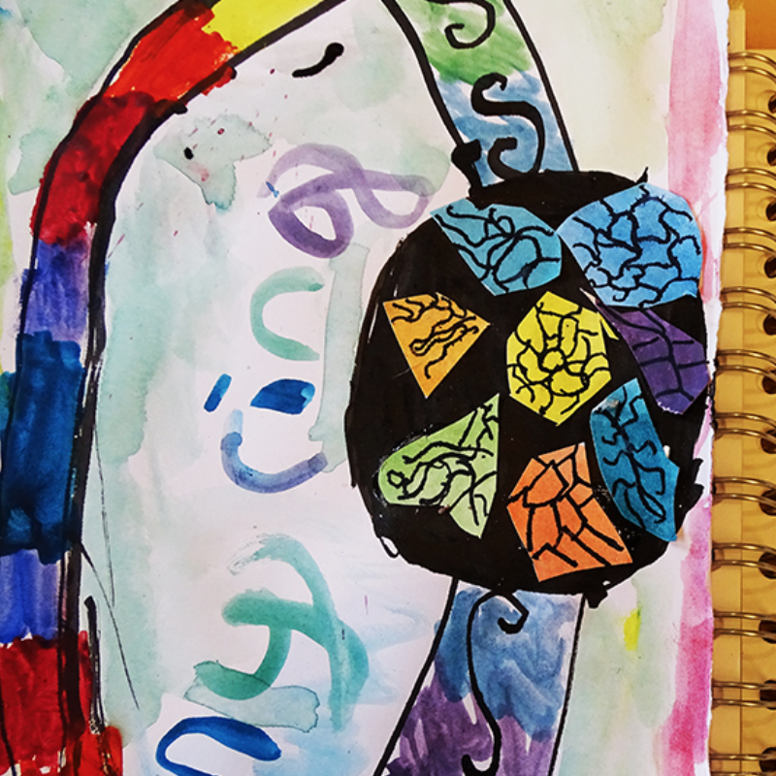
Year 3
www.accessart.org.uk

Slide 16
 | Year 3- Generating Ideas |  |  |  | By the end of Year 3 Children should be able to…
Generating Ideas Teachers should: Feel able to model sketchbook use alongside pupils (i.e. keep their own sketchbook) Let pupils discover and share for themselves Enable pupils to build confidence in their own ideas | Through Sketchbooks | By Looking & Talking | Through Making | Digital Media | Gather and review information from different sources (primary and secondary), references and resources related to their ideas and intentions Use a sketchbook for different purposes, including recording observations, planning and shaping ideas
 | Continue to develop a “sketchbook habit”, using a sketchbook as a place to record individual response to the world. Begin to feel a sense of ownership about the sketchbook, which means allowing every child to work at own pace, following own exploration Practice and develop sketchbook use, incorporating the following activities: drawing to discover, drawing to show you have seen, drawing to experiment, exploring colour, exploring paint, testing ideas, collecting, sticking, writing notes, looking back, thinking forwards and around… | Enjoy looking at artwork made by artists, craftspeople, architects and designers. Discuss artist’s intention and reflect upon your response. Look at artforms beyond the visual arts: literature, drama, music, film etc and explore how they relate to your visual art form. Look at a variety of types of source material and understand the differences. Be given time and space to engage with the physical world to stimulate a creative response (visiting, seeing, holding, hearing), including found and manmade objects. Develop questions to ask when looking at artworks and /or stimulus: Describe what you see What do you like/dislike? Why What is the artist saying to us in this artwork? How does it make you feel? How might it inspire you in making your own art? | Use growing knowledge of how materials and medium act, to help develop ideas. Continue to generate ideas through space for playful making. Explore how ideas translate and develop through different medium (i.e. a drawing in pencil or a drawing in charcoal). | Use digital media to identify and research artists, craftspeople, architects and designers.

Slide 17
 | Year 3 - Making |  |  |  | By the end of Year 3 Children should be able to…
Making Teachers should: Balance time in which you sensitively model a technique, with plenty of time for pupils to enjoy open-ended exploration, and project-based learning Have the confidence to celebrate places where pupils diverge from the task (as being signs that they are owning their learning) | Drawing | Drawing, Painting & Collage | 3D | Digital & Animation | Develop practical skills by experimenting with and testing the qualities of a range of materials and techniques Select and use appropriately a variety of materials and techniques in order to create their own work. Be excited by the potential to create and feel empowered to begin to undertake their own exploration
 | Practice observational drawing from the figure, exploring careful looking, intention, seeing big shapes, drawing with gesture, and quick sketching, e.g. Using gesture in drawing Using observational drawing as a starting point, fed by imagination, design typography, e.g. Typography for children Continue to familiarize with sketchbook / drawing exercises. Let children describe how to undertake the ones they know as means of recap/reminder and introduce new ones, which are practiced regularly. Drawing exercises | Make larger scale drawing from observation and imagination, e.g. Cheerful-orchestra drawing project Apply and build upon colour mixing and mark-making skills previously learnt, thinking about how certain colour ranges/combinations affect the outcome, e.g. Stencils composition and mark making and Exploring colour Explore painting on new surfaces using colour as decoration e.g. Paint clay tiles | Make an armature from paper and tape and use as the basis to explore modelling with Modroc to make sculpture, e.g. Roald Dahl and Quentin Blake sculpture resource Explore a simple clay technique such as making slab pieces, and decorate them relief patterns based upon observational drawing skills, e.g. Clay fruit tiles Explore how combinations of materials such as wire, paper, fabric, string, card can be transformed into sculpture, discovering how best to manipulate them (cut, tear, bend, fold) and fasten them together (tie, bind, stick). Drawing and making flowers | Building on mark-making and observational skills, make drawings of animals, people and vehicles Use scissors to dissect the and reconstruct them into drawings that move, e.g. Making moving drawings Use digital media to make animations from the drawings that move Animating articulated beasts

Slide 18
 | Year 3 - Evaluating |  |  | By the end of Year 3 Children should be able to…
Evaluating Teachers should: Be aware of the importance of sensitively unearthing intention, which may not always be apparent in end result Ensure evaluation activities take place throughout projects, rather than just at the end, so that they benefit and shape the creative process | As a Class | In Small Groups | One to One | Take pleasure in the work they have created and see that it gives other people pleasure Take the time to reflect upon what they like and dislike about their work in order to improve it Understand how evaluating creative work during the process, as well as at the end, helps feed the process. Take photographs and videos and use digital media as a way to re-see work
 | Enjoy listening to other peoples views about artwork made by others. Feel able to express and share an opinion about the artwork. Think about why the work was made, as well as how. | Share work to others in small groups, and listen to what they think about what you have made. Make suggestions about other people’s work, using things you have seen or experienced yourself. Take photos of work made so that a record can be kept, to be added to a digital folder/presentation to capture progression. Use documenting the artwork as an opportunity for discussion about how to present work, and a chance for pupils to use digital media. | Talk to a peer or teacher about the artwork made and share what you have enjoyed during the process, and what you like about the end result. Discuss problems which came up and how they were solved. Think about what you might try next time.

Slide 19
 | Year 3 – Knowledge & Understanding |  | By the end of Year 3 Children should be able to…
Knowledge & Understanding Teachers should: Recognise that in art, a more valuable and relevant learning experience comes from underpinning technical and formal knowledge with an experiential understanding about what it is to be a creative human. | Formal | Experiential
 | Each child should: Know the names of tools, techniques and formal elements (in pink above and below) Know that different forms of creative works are made by artists, craftspeople, and designers from all cultures and times, for different purposes. Be able to know and describe the work of some artists, craftspeople, architects and designers, including artists who are contemporary, female, and from various ethnicities Be able to talk about the materials, techniques and processes they have used, using an appropriate vocabulary Be able to demonstrate how to safely use some of the tools and techniques they have chose to work with | Each child should be given the opportunity to: Discover that art is subjective (we all have our own legitimate understanding) Experience the connection between brain, hand and eye Understand ideas can come through hands-on exploration Develop their knowledge of what different materials and techniques can offer the creative individual Work at different scales, alone and in groups Feel safe enough to take creative risks and follow their intuition (fed with skills knowledge) Share their journey and outcomes with others. Feel celebrated and feel able to celebrate others

Slide 20
 | Year 3 – Vocab & Assessment Questions | By the end of Year 3 Children should be able to…
Assessment Questions Teachers should consider assessment as a holistic practice, which takes place during every art lesson through conversation with pupils: Tell me about that you are making and what inspired you What might you do next? Tell me about the materials and techniques you are using What have you discovered? How do you feel about the end result? What kinds of problems did you encounter and how did you get round them? Tell me about things you really liked or enjoyed What would you like to explore more of? Remember! “Creativity is a fragile process that is hard to measure and assess and should always be nurtured and supported”

Slide 21
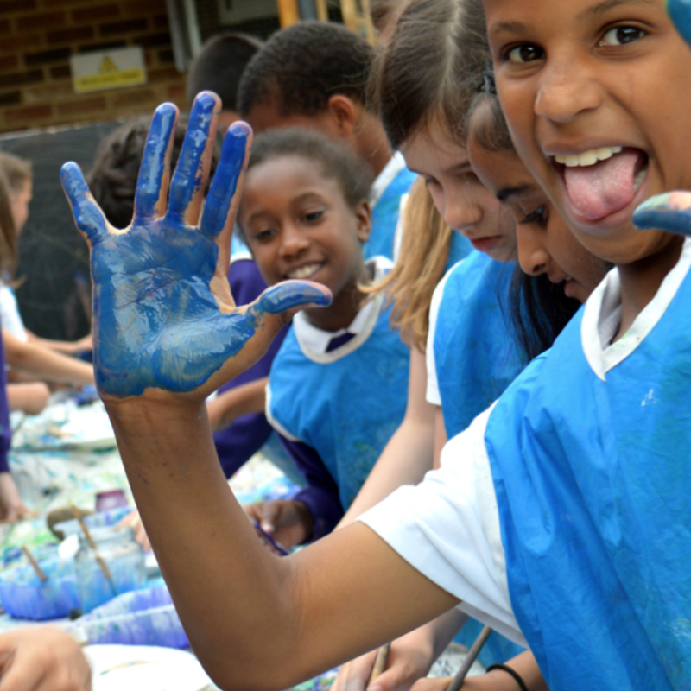
Year 4
www.accessart.org.uk

Slide 22
 | Year 4 – Generating Ideas |  |  |  | By the end of Year 4 Children should be able to…
Generating Ideas Teachers should: Feel able to model sketchbook use alongside pupils (i.e. keep their own sketchbook) Let pupils discover and share for themselves Enable pupils to build confidence in their own ideas | Through Sketchbooks | By Looking & Talking | Through Making | Digital Media | Use sketchbooks and drawing to purposefully improve understanding, inform ideas and explore potential Understand sketchbooks are places to explore personal creativity, and as such they should be experimental, imperfect, ask questions, demonstrate inquisitive exploration Use sketchbooks, together with other resources, to understand how inspiration can come from many rich and personal sources to feed into creative projects
 | Continue to develop a “sketchbook habit”, using a sketchbook as a place to record individual response to the world. Begin to feel a sense of ownership about the sketchbook, which means allowing every child to work at own pace, following own exploration Practice and develop sketchbook use, incorporating the following activities: drawing to discover, drawing to show you have seen, drawing to experiment, exploring colour, exploring paint, testing ideas, collecting, sticking, writing notes, looking back, thinking forwards and around, reflecting, making links… | Enjoy looking at artwork made by artists, craftspeople, architects and designers. Discuss artist’s intention and reflect upon your response. Look at artforms beyond the visual arts: literature, drama, music, film etc and explore how they relate to your visual art form. Look at a variety of types of source material and understand the differences. Be given time and space to engage with the physical world to stimulate a creative response (visiting, seeing, holding, hearing), including found and manmade objects. Develop questions to ask when looking at artworks and /or stimulus: Describe the artwork. What do you like/dislike? Why? Which other senses can you bring to this artwork? What is the artist saying to us in this artwork? How might it inspire you to make your own artwork? If you could take this art work home, where would you put it and why? Take part in small scale crits throughout so that brainstorming becomes part of the creative process. | Use growing knowledge of how materials and medium act, to help develop ideas. Continue to generate ideas through space for playful making. Explore how ideas translate and develop through different medium (i.e. a drawing in pencil or a drawing in charcoal). | Use digital media to identify and research artists, craftspeople, architects and designers.

Slide 23
 | Year 4 - Making |  |  |  | By the end of Year 4 Children should be able to…
Making Teachers should: Balance time in which you sensitively model a technique, with plenty of time for pupils to enjoy open-ended exploration, and project-based learning Have the confidence to celebrate places where pupils diverge from the task (as being signs that they are owning their learning) | Drawing & Printmaking | Painting/Collage/Sketchbooks | Sculpture | Design | Investigate the nature and qualities of different materials and processes Apply technical skills to improve quality of work, combined with beginning to listen and trust “instinct” to help make choices Be excited by the potential to create and feel empowered to undertake their own exploration
 | Continue to familiarize with sketchbook / drawing exercises. Let children describe how to undertake the ones they know as means of recap/reminder and introduce new ones, which are practiced regularly. Start here drawing Apply these skills to a variety of media, exploring outcomes in an open-ended manner throughout the other projects described here. Use growing technical skill and knowledge of different drawing materials, combined with increasing confidence in making a creative response to a wide range of stimuli, to explore more experimental drawing, following child’s own interests/affinities. Please see Teaching for the journey Layering of media, mixing of drawing media, e.g. Wax resist with coloured inks | Create a one-off project sketchbook which can inform future sketchbook practice, consolidating old skills and introducing new skills (including: creating spaces and places in sketchbook to help creative thinking, exploring and revealing own creative journey from a shared starting point). Taking ownership of your sketchbook Combine artforms such as collage, painting and printmaking in mixed media projects e.g. Screenprinting inspired by matisse | Work with a modelling material (clay or plasticine) to create quick 3d figurative sketches from life or imagination. Combine with developing visual literacy skills so that the 3d sketches explore how we read and communicate emotion and idea, e.g. Quick clay figurative sketches Develop visual literacy skills and discover how context and intention can change the meaning of objects, e.g. Making a pocket-gallery Construct with a variety of materials (wool, string, twigs, found objects, paper etc.) exploring how to bring different media together, both technically and visually, e.g. Building_nests | Develop design through making skills and collaborative working skills through fashion design. Explore paper and card manipulation skills to build 3d forms. Manipulating paper and Pin and paper fashion and Barbie and Ken transformation/ and Paperback figures Extend into an exploration of fabric, deconstructing old clothes and reconstructing elements into new items. e.g. Psyches inspired dress

Slide 24
 | Year 4 – Evaluating |  |  | By the end of Year 4 Children should be able to…
Evaluating Teachers should: Be aware of the importance of sensitively unearthing intention, which may not always be apparent in end result Ensure evaluation activities take place throughout projects, rather than just at the end, so that they benefit and shape the creative process | As a Class | In Small Groups | One to One | Reflect regularly upon their work, throughout the creative process Look to the work of others (pupils and artists) to identify how to feed their own work Take photographs and videos and use digital media as a way to re-see work
 | Enjoy listening to other peoples views about artwork made by others. Feel able to express and share an opinion about the artwork. Think about why the work was made, as well as how. | Share work to others in small groups, and listen to what they think about what you have made. Make suggestions about other people’s work, using things you have seen or experienced yourself. Take photos of work made so that a record can be kept, to be added to a digital folder/presentation to capture progression. Use documenting the artwork as an opportunity for discussion about how to present work, and a chance for pupils to use digital media. | Talk to a peer or teacher about the artwork made and share what you have enjoyed during the process, and what you like about the end result. Discuss problems which came up and how they were solved. Think about what you might try next time.

Slide 25
 | Year 4 – Knowledge & Understanding |  | By the end of Year 4 Children should be able to…
Knowledge & Understanding Teachers should: Recognise that in art, a more valuable and relevant learning experience comes from underpinning technical and formal knowledge with an experiential understanding about what it is to be a creative human. | Formal | Experiential
 | Each child should: Know the names of tools, techniques and formal elements (in pink above and below) Know about and describe some of the key ideas, techniques and working practices of a variety of artists, craftspeople, architects and designers from all cultures and times, for different purposes. Be able to know and describe the work of some artists, craftspeople, architects and designers, including artists who are contemporary, female, and from various ethnicities Be able to talk about the materials, techniques and processes they have used, using an appropriate vocabulary Be able to demonstrate how to safely use some of the tools and techniques they have chose to work with | Each child should be given the opportunity to: Discover that art is subjective (we all have our own legitimate understanding) Experience the connection between brain, hand and eye Understand ideas can come through hands-on exploration Develop their knowledge of what different materials and techniques can offer the creative individual Work at different scales, alone and in groups Feel safe enough to take creative risks and follow their intuition (fed with skills knowledge) Share their journey and outcomes with others. Feel celebrated and feel able to celebrate others

Slide 26
 | Year 4 – Vocab & Assessment Questions | By the end of Year 4 Children should be able to…
Assessment Questions Teachers should consider assessment as a holistic practice, which takes place during every art lesson through conversation with pupils: Tell me about that you are making and what inspired you What might you do next? Tell me about the materials and techniques you are using What have you discovered? How do you feel about the end result? What kinds of problems did you encounter and how did you get round them? Tell me about things you really liked or enjoyed What would you like to explore more of? Remember! “Creativity is a fragile process that is hard to measure and assess and should always be nurtured and supported”

Slide 27
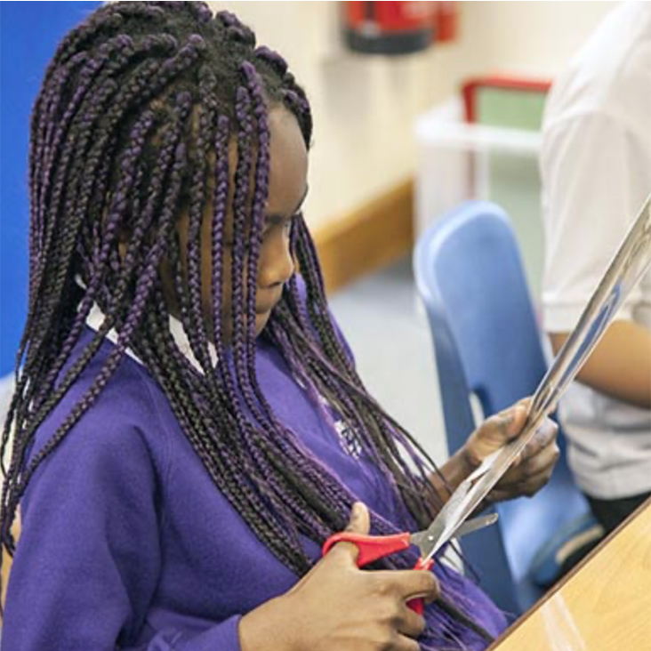
Year 5
www.accessart.org.uk

Slide 28
 | Year 5 – Generating Ideas |  |  |  | By the end of Year 5 Children should be able to…
Generating Ideas Teachers should: Feel able to model sketchbook use alongside pupils (i.e. keep their own sketchbook) Let pupils discover and share for themselves Enable pupils to build confidence in their own ideas | Through Sketchbooks | By Looking & Talking | Through Making | Digital Media | Engage in open-ended research and exploration to initiate and develop personal ideas Confidently use sketchbooks for a variety of purposes including recording observations, developing ideas, testing materials, planning and recording information Understand sketchbooks are places to explore personal creativity, and as such they should be experimental, imperfect, ask questions, demonstrate inquisitive exploration
 | Continue to develop a “sketchbook habit”, using a sketchbook as a place to record individual response to the world. Begin to feel a sense of ownership about the sketchbook, which means allowing every child to work at own pace, following own exploration. Increasingly see the sketchbook as a place which raises questions which can be explored/answered outside the sketchbook, so that the link between sketchbook and journey and outcome becomes understood. Practice and develop sketchbook use, incorporating the following activities: drawing to discover, drawing to show you have seen, drawing to experiment, exploring colour, exploring paint, testing ideas, collecting, sticking, writing notes, looking back, thinking forwards and around, reflecting, making links… | Enjoy looking at artwork made by artists, craftspeople, architects and designers. Discuss artist’s intention and reflect upon your response. Look at artforms beyond the visual arts: literature, drama, music, film etc and explore how they relate to your visual art form. Look at a variety of types of source material and understand the differences. Be given time and space to engage with the physical world to stimulate a creative response (visiting, seeing, holding, hearing), including found and manmade objects. Develop questions to ask when looking at artworks and /or stimulus: Describe the artwork. What do you like/dislike? Why? Which other senses might you bring to this artwork? How does it make you feel? What is the artist saying to us in this artwork? How might it inspire you to make your own artwork? Who or what else might you look at to help feed your creativity? Take part in small scale crits throughout so that brainstorming becomes part of the creative process. | Use growing knowledge of how materials and medium act, to help develop ideas. Continue to generate ideas through space for playful making. Explore how ideas translate and develop through different medium (i.e. a drawing in pencil or a drawing in charcoal). | Use digital media to identify and research artists, craftspeople, architects and designers. Use camera phones (still and video) to help ”see” and “collect” (digital sketchbook).

Slide 29
 | Year 5 - Making |  |  | By the end of Year 5 Children should be able to…
Making Teachers should: Balance time in which you sensitively model a technique, with plenty of time for pupils to enjoy open-ended exploration, and project-based learning Have the confidence to celebrate places where pupils diverge from the task (as being signs that they are owning their learning) | Architecture & Making | Drawing, Making, Colour | Design & Making | Confidently investigate and explore new materials, beginning to lead their own search for new experiences Use acquired technical expertise, combined with beginning to listen and trust “instinct” to help make choices, to make work which effectively reflects ideas and intentions Feel safe enough to take creative risks
 | Explore architecture of another time and / or culture, and make individual work in response to what is seen. Enable evolution of ideas through a combination of design through making and drawn inspiration. E.g. Architecture and mark making Develop visual literacy skills: explore how we look at and respond to things people have made, and then include this awareness when making sculpture e.g. Inspired by anglo saxon houses | Continue with the key drawing exercises Drawing exercises Explore the relationship of line, form and colour. Follow a series of guided activities which each offer pupils an opportunity to make their own individual creative response. e.g. Inspired by Miro and Building a communal drawing Explore sculptural ideas of balance (physical and aesthetic) and creative risk taking and play, e.g. Making sculpture and drawing | Explore relationship between sculpture and design through a sketchbook project which takes film/literature/drama as its starting point and facilitates an open-ended sculptural exploration, with children working at their own pace and following their own journey e.g. Developing sketchbook work Enable sketchbook work above to evolve and inform into a sculpture project. Combine and construct with a variety of materials, including modelling and paint, e.g. Supersized jewellery and Fabulous-fish Explore scaling up drawings, bringing in all mark-making skills previously learnt, and using technique to provide opportunity to transform original, e.g. Flat yet sculptural drawing Paint on new surfaces (e.g. stone, fabric, walls, floors and work collaboratively to produce images in new contexts, e.g Communal summer picnic drawing orTreasured fossils

Slide 30
 | Year 5 - Evaluating |  |  | By the end of Year 5 Children should be able to…
Evaluating Teachers should: Be aware of the importance of sensitively unearthing intention, which may not always be apparent in end result Ensure evaluation activities take place throughout projects, rather than just at the end, so that they benefit and shape the creative process | As a Class | In Small Groups | One to One | Regularly analyze and reflect upon progress taking into account of intention Look to the work of others (pupils and artists) to identify how to feed their own work Take photographs and videos and use digital media as a way to re-see work
 | Feel able to express and share an opinion about the artwork. Discuss why the work was made, as well as how. Share your response to the artwork. Ask questions about process, technique, idea or outcome. | Share work to others in small groups, and listen to what they think about what you have made. Make suggestions about other people’s work, using things you have seen or experienced yourself. Take photos of work made so that a record can be kept, to be added to a digital folder/presentation to capture progression. Use documenting the artwork as an opportunity for discussion about how to present work, and a chance for pupils to use digital media Present work in retrospect, i.e. to class, assembly or parents. | Talk to a peer or teacher about the artwork made and share what you have enjoyed during the process, and what you like about the end result. Discuss problems which came up and how they were solved. Think about what you might try next time. Share how other artists/artwork inspired you and how your work fits into larger context.

Slide 31
 | Year 5 – Knowledge & Understanding |  | By the end of Year 5 Children should be able to…
Knowledge & Understanding Teachers should: Recognise that in art, a more valuable and relevant learning experience comes from underpinning technical and formal knowledge with an experiential understanding about what it is to be a creative human. | Formal | Experiential
 | Each child should: Know the names of tools, techniques and formal elements (in pink above and below) Research and discuss ideas and approaches of range of artists, craftspeople, architects and designers from all cultures and times, for different purposes. Be able to know and describe the work of some artists, craftspeople, architects and designers, including artists who are contemporary, female, and from various ethnicities Be able to talk about the materials, techniques and processes they have used, using an appropriate vocabulary. Describe processes used and how they hope to achieve high quality outcomes Be able to demonstrate how to safely use some of the tools and techniques they have chose to work with | Each child should be given the opportunity to: Discover that art is subjective (we all have our own legitimate understanding) Experience the connection between brain, hand and eye Understand ideas can come through hands-on exploration Develop their knowledge of what different materials and techniques can offer the creative individual Work at different scales, alone and in groups Feel safe to take creative risks and follow their intuition (fed with skills knowledge) and define their own creative journey Share their journey and outcomes with others. Feel celebrated and feel able to celebrate others

Slide 32
 | Year 5 – Vocab & Assessment Questions | By the end of Year 5 Children should be able to…
Assessment Questions Teachers should consider assessment as a holistic practice, which takes place during every art lesson through conversation with pupils: Tell me about that you are making and what inspired you What might you do next? Tell me about the materials and techniques you are using What have you discovered? How do you feel about the end result? What kinds of problems did you encounter and how did you get round them? Tell me about things you really liked or enjoyed What would you like to explore more of? What is the potential of what you have done? What could you do next? Remember! “Creativity is a fragile process that is hard to measure and assess and should always be nurtured and supported”

Slide 33
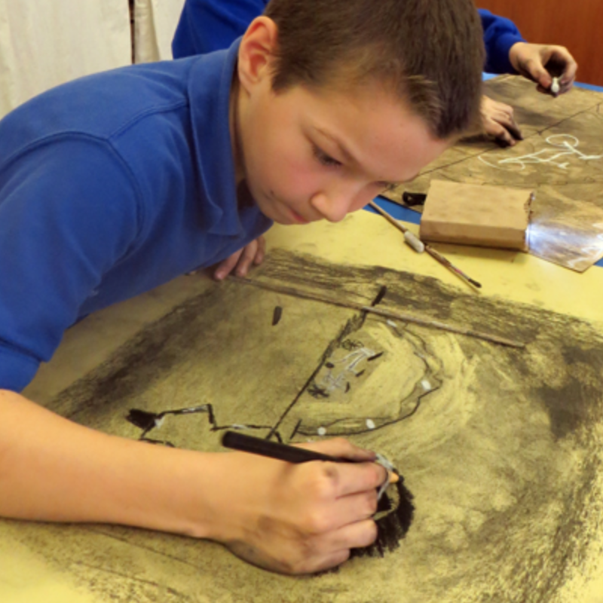
Year 6
www.accessart.org.uk

Slide 34
 | Year 6 – Generating Ideas |  |  |  | By the end of Year 6 Children should be able to…
Generating Ideas Teachers should: Feel able to model sketchbook use alongside pupils (i.e. keep their own sketchbook) Let pupils discover and share for themselves Enable pupils to build confidence in their own ideas | Through Sketchbooks | By Looking & Talking | Through Making | Digital Media | Independently develop a range of ideas which show curiosity, imagination and originality Investigate, research and test ideas and plans using sketchbooks and other approaches Understand sketchbooks are places to explore personal creativity, and as such they should be experimental, imperfect, ask questions, demonstrate inquisitive exploration
 | Continue to develop a “sketchbook habit”, using a sketchbook as a place to record individual response to the world. Begin to feel a sense of ownership about the sketchbook, which means allowing every child to work at own pace, following own exploration. Increasingly see the sketchbook as a place which raises questions which can be explored/answered outside the sketchbook, so that the link between sketchbook and journey and outcome becomes understood. Practice and develop sketchbook use, incorporating the following activities: drawing to discover, drawing to show you have seen, drawing to experiment, exploring colour, exploring paint, testing ideas, collecting, sticking, writing notes, looking back, thinking forwards and around, reflecting, making links… | Enjoy looking at artwork made by artists, craftspeople, architects and designers. Discuss artist’s intention and reflect upon your response. Look at artforms beyond the visual arts: literature, drama, music, film etc and explore how they relate to your visual art form. Look at a variety of types of source material and understand the differences. Be given time and space to engage with the physical world to stimulate a creative response (visiting, seeing, holding, hearing), including found and manmade objects. Develop questions to ask when looking at artworks and /or stimulus: Describe the artwork. What do you like/dislike? Why? Which other senses might you bring to this artwork? How does it make you feel? What is the artist saying to us in this artwork? How might it inspire you to make your own artwork? Who or what else might you look at to help feed your creativity? Take part in small scale crits throughout so that brainstorming becomes part of the creative process. | Use growing knowledge of how materials and medium act, to help develop ideas. Continue to generate ideas through space for playful making. Explore how ideas translate and develop through different medium (i.e. a drawing in pencil or a drawing in charcoal). | Use digital media to identify and research artists, craftspeople, architects and designers. Use camera phones (still and video) to help ”see” and “collect” (digital sketchbook).

Slide 35
 | Year 6 - Making |  |  |  | By the end of Year 6 Children should be able to…
Making Teachers should: Balance time in which you sensitively model a technique, with plenty of time for pupils to enjoy open-ended exploration, and project-based learning Have the confidence to celebrate places where pupils diverge from the task (as being signs that they are owning their learning) | Drawing, Making | Drawing & Narrative | Puppetry | Design & Making | Independently take action to refine technical and craft skills to improve mastery of materials and techniques Confidently follow intuition and instinct during the making process, making intelligent and confident creative choices Independently select and effectively use relevant processes in order to create successful and finished work Feel safe enough to take creative risks, enjoying the journey
 | Continue with the key drawing exercises Drawing exercises Revisit still life. Develop drawing skills using observational drawing e.g. Graphic inky still life or Still life in cubist style Explore drawing and mark making on new surfaces, e.g. clay, linking to genres such as portraiture or landscape, e.g. Exploring portraits Develop clay (and drawing) skills by creating pinch pots based upon still life observation, e.g. Fruit pinch pots Explore geometric design/pattern / structure, e.g. Wave bowls | Explore sequential drawing and narrative e.g. manga and graphic novels, possibly linking into develop into set design (see Design & Making), e.g. Manga | Develop drawing and making skills and combine with narrative/character development and make puppets. Using tools to cut intricate shapes and use fastenings to create moving parts. Work collaboratively to perform, and use digital media to record e.g. Shadow puppets and whiteboards and Shadow puppet play | Explore set design using mixed media and linking literature, drama, music and design, e.g. Set design with primary children Explore transformation of materials following own journey to produce an object which conveys personality of maker/designer, e.g. Making Seats

Slide 36
 | Year 6 - Evaluating |  |  | By the end of Year 6 Children should be able to…
Evaluating Teachers should: Be aware of the importance of sensitively unearthing intention, which may not always be apparent in end result Ensure evaluation activities take place throughout projects, rather than just at the end, so that they benefit and shape the creative process | As a Class | In Small Groups | One to One | Provide a reasoned evaluation of both their own work ad professionals work which take into account starting points, intentions and contexts Regularly analyze and reflect upon progress taking into account of intention Take photographs and videos and use digital media as a way to re-see work
 | Feel able to express and share an opinion about the artwork. Discuss why the work was made, as well as how. Share your response to the artwork. Ask questions about process, technique, idea or outcome. | Share work to others in small groups, and listen to what they think about what you have made. Make suggestions about other people’s work, using things you have seen or experienced yourself. Take photos of work made so that a record can be kept, to be added to a digital folder/presentation to capture progression. Use documenting the artwork as an opportunity for discussion about how to present work as an artist/maker/designer would to a client, and a chance for pupils to use digital media Present work in retrospect, i.e. to class, assembly or parents. | Talk to a peer or teacher about the artwork made and share what you have enjoyed during the process, and what you like about the end result. Discuss problems which came up and how they were solved. Think about what you might try next time. Share how other artists/artwork inspired you and how your work fits into larger context.

Slide 37
 | Year 6 – Knowledge & Understanding |  | By the end of Year 6 Children should be able to…
Knowledge & Understanding Teachers should: Recognise that in art, a more valuable and relevant learning experience comes from underpinning technical and formal knowledge with an experiential understanding about what it is to be a creative human. | Formal | Experiential
 | Each child should: Know the names of tools, techniques and formal elements (in pink above and below) Be happy to describe, interpret and explain the work, ideas and working practices of artists, craftspeople, architects and designers from all cultures and times, for different purposes. Be able to know and describe the work of some artists, craftspeople, architects and designers, including artists who are contemporary, female, and from various ethnicities Be able to talk about the materials, techniques and processes they have used, using an appropriate vocabulary. Describe processes used and how they hope to achieve high quality outcomes Be able to demonstrate how to safely use some of the tools and techniques they have chose to work with | Each child should be given the opportunity to: Discover that art is subjective (we all have our own legitimate understanding) Experience the connection between brain, hand and eye Understand ideas can come through hands-on exploration Develop their knowledge of what different materials and techniques can offer the creative individual Work at different scales, alone and in groups Feel safe to take creative risks and follow their intuition (fed with skills knowledge) and define their own creative journey Share their journey and outcomes with others. Feel celebrated and feel able to celebrate others

Slide 38
 | Year 6 – Vocab & Assessment Questions | By the end of Year 6 Children should be able to…
Assessment Questions Teachers should consider assessment as a holistic practice, which takes place during every art lesson through conversation with pupils: Tell me about that you are making and what inspired you What might you do next? Tell me about the materials and techniques you are using What have you discovered? How do you feel about the end result? What kinds of problems did you encounter and how did you get round them? Tell me about things you really liked or enjoyed What would you like to explore more of? What is the potential of what you have done? What could you do next? Remember! “Creativity is a fragile process that is hard to measure and assess and should always be nurtured and supported”

