Slide 1
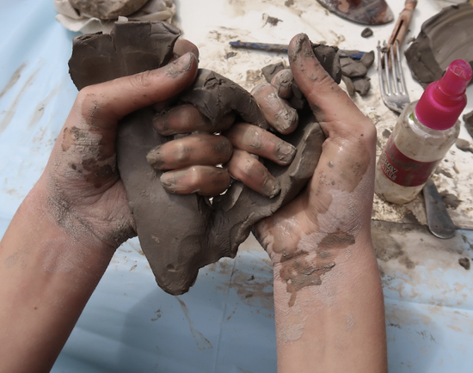
 | Year 1 – Generating Ideas | By the end of Year 1 Children should be able to…
Making as Playing: Generate ideas through playful, hands-on, exploration of materials without being constricted towards a pre-defined outcome. |  | Recognise that ideas can be generated through doing as well as thinking Recognise that ideas can be expressed through art Experiment with an open mind

Slide 2
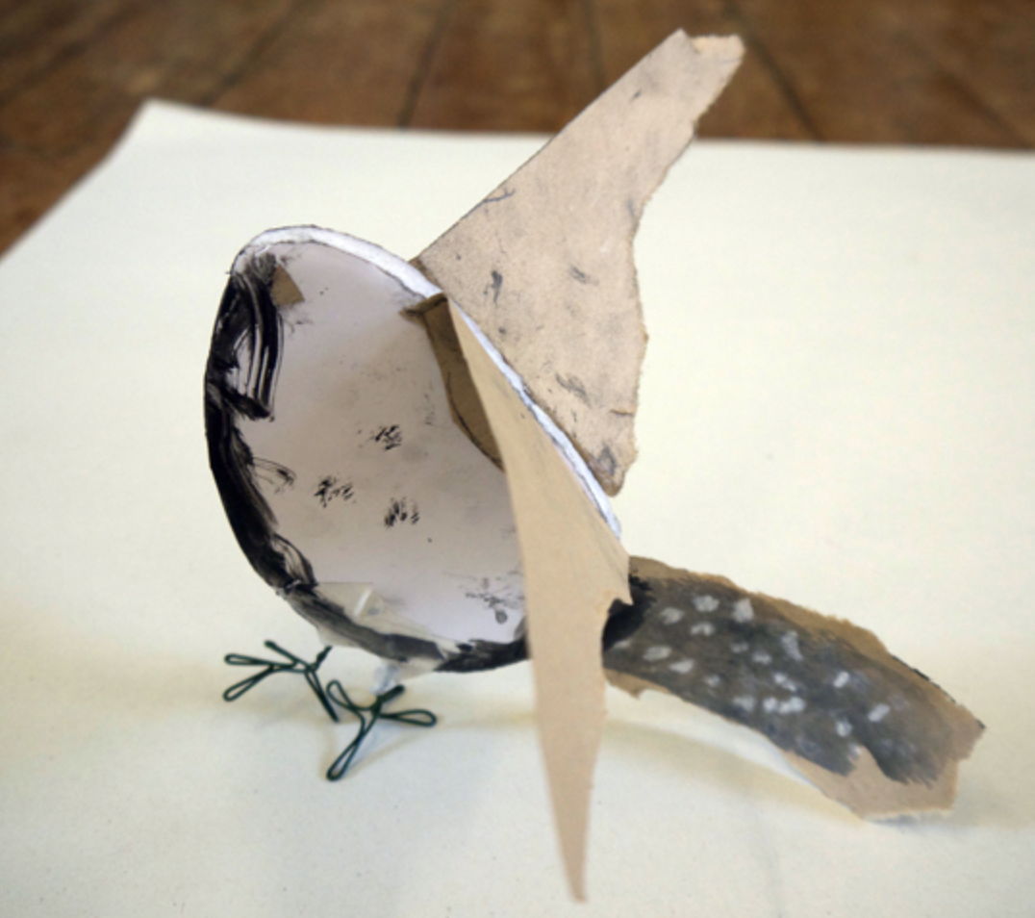
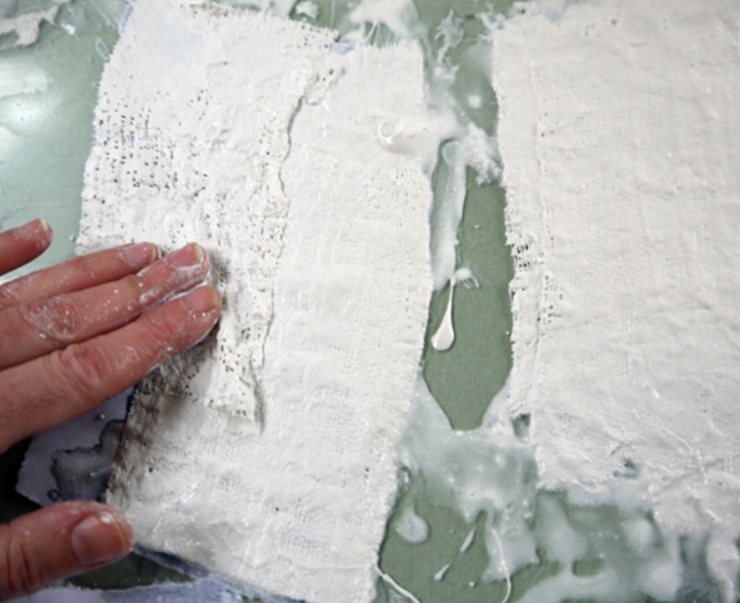
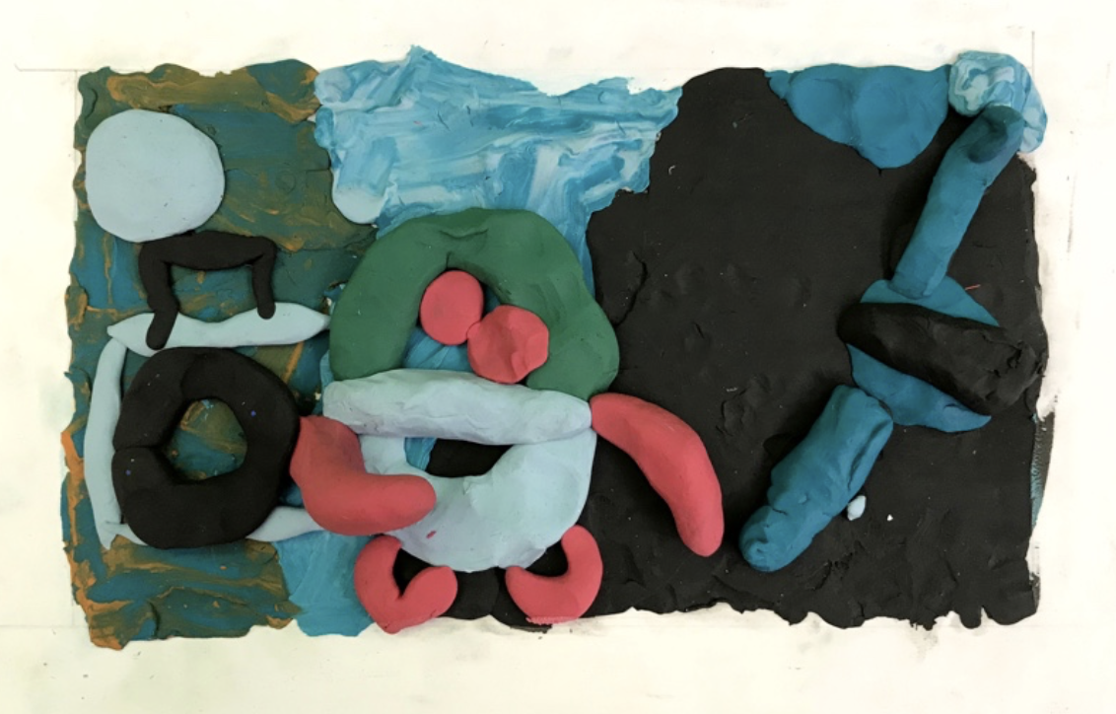
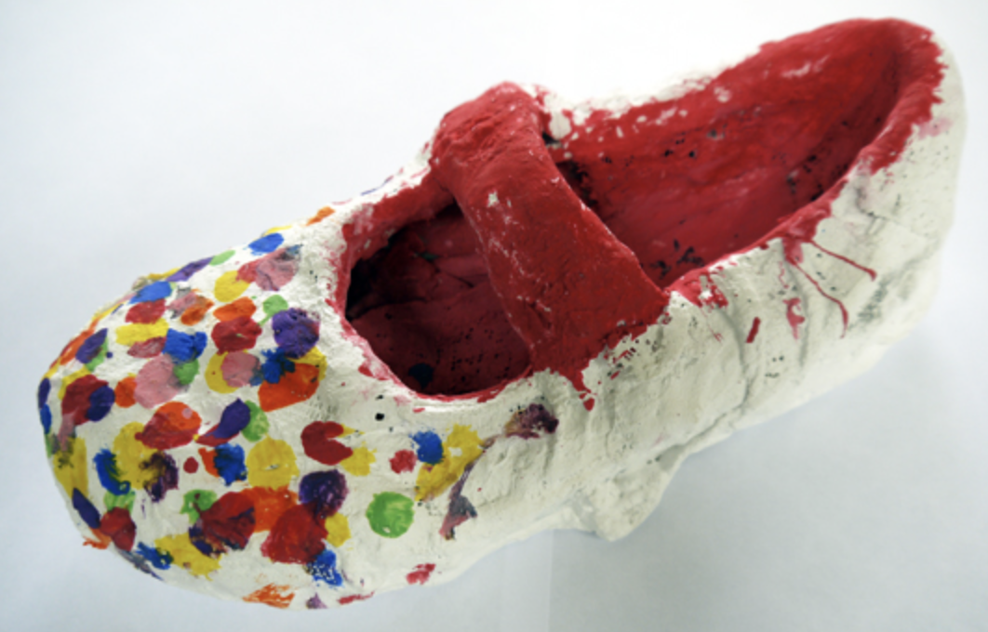
 | Year 1 - Making | By the end of Year 1 Children should be able to…
Explore, discover and invent ways for 2d to transform into 3d sculpture. This might be through creating drawings or prints on paper which are then folded, through collage which becomes relief, through 2d shapes which are cut out and constructed with. For example making birds Explore modelling materials such as Modroc, clay and plasticine in an open-ended manner, to discover what they might do. modroc plasterboard or making modroc sculpture Use basic tools to help deconstruct (scissors) and then construct (glue sticks). |  | Try out a range of materials & processes and recognise they have different qualities Explore materials in a playful and open-ended manner Use materials purposefully to achieve particular characteristics or qualities Be excited by the potential to create. Understand that art is different to many subjects at school: through art, they can invent and discover

Slide 3
 | Year 1 – Vocab & Assessment Questions
Assessment Questions Teachers should consider assessment as a holistic practice, which takes place during every art lesson through conversation with pupils: Tell me about what you are making What might you do next? Tell me about what you have made Remember! “Creativity is a fragile process that is hard to measure and assess and should always be nurtured and supported”

Slide 4
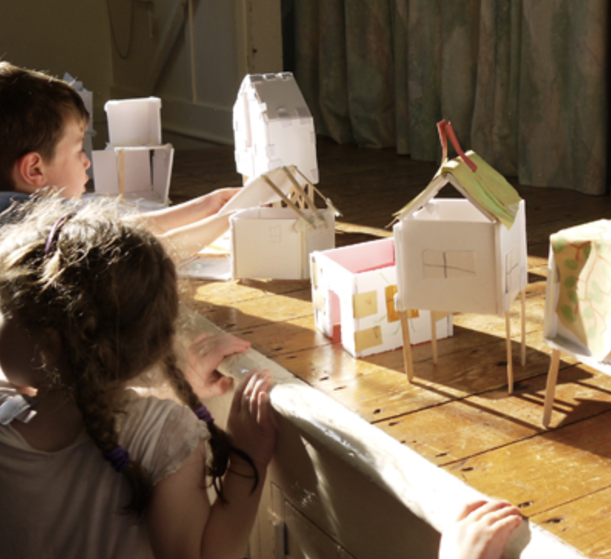
 | Year 2 – Generating Ideas | By the end of Year 2 Children should be able to…
Through Making Generate ideas through exploration of materials, building an understanding of what each material can do, how it can be constructed, being open during the process to unexpected ideas. |  | Recognise that ideas can be generated through doing as well as thinking Recognise that ideas can be expressed through art Experiment with an open mind Enjoy trying out different activities and make both informed, and intuitive choices about what to do next, letting practical experience feed ideas

Slide 5
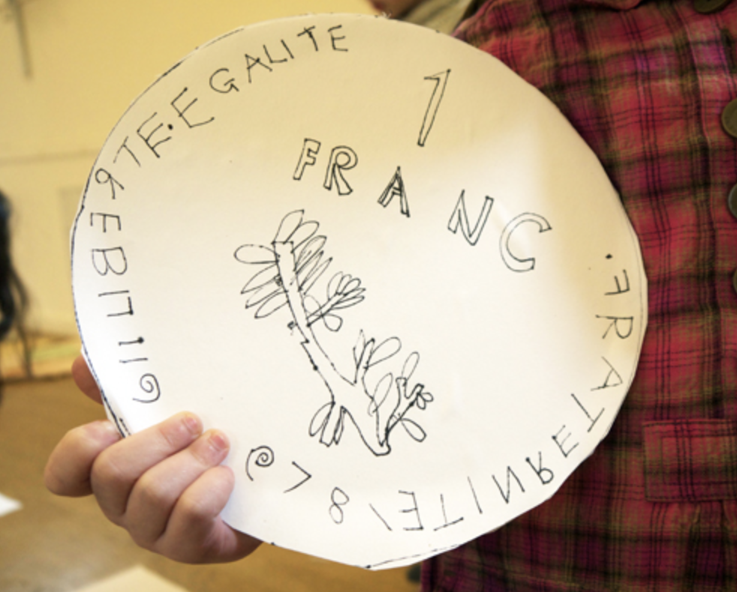
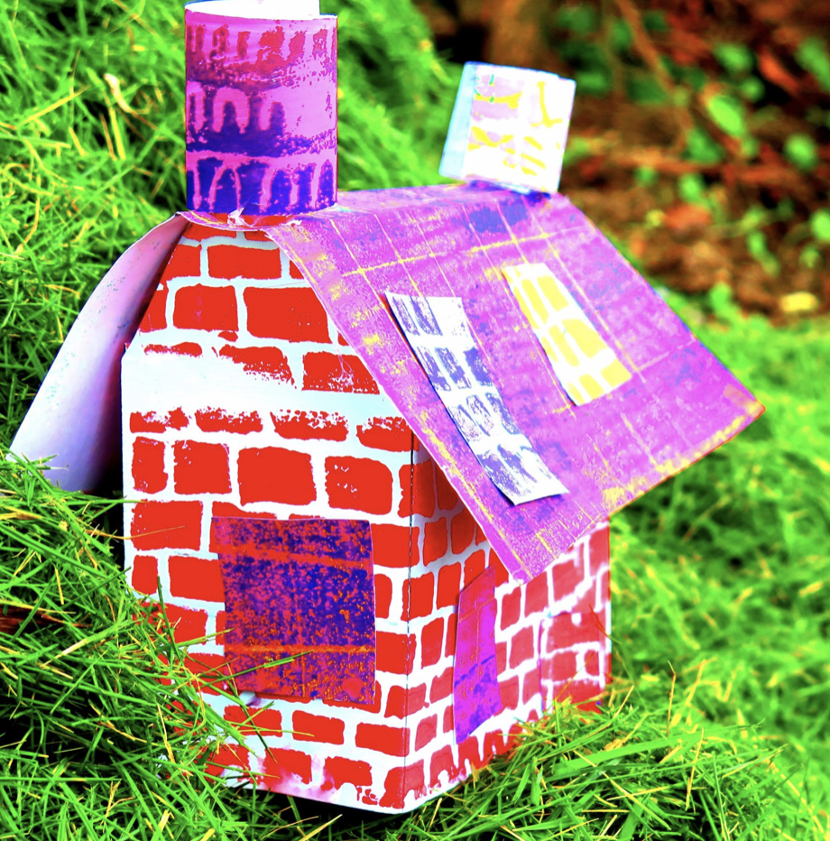
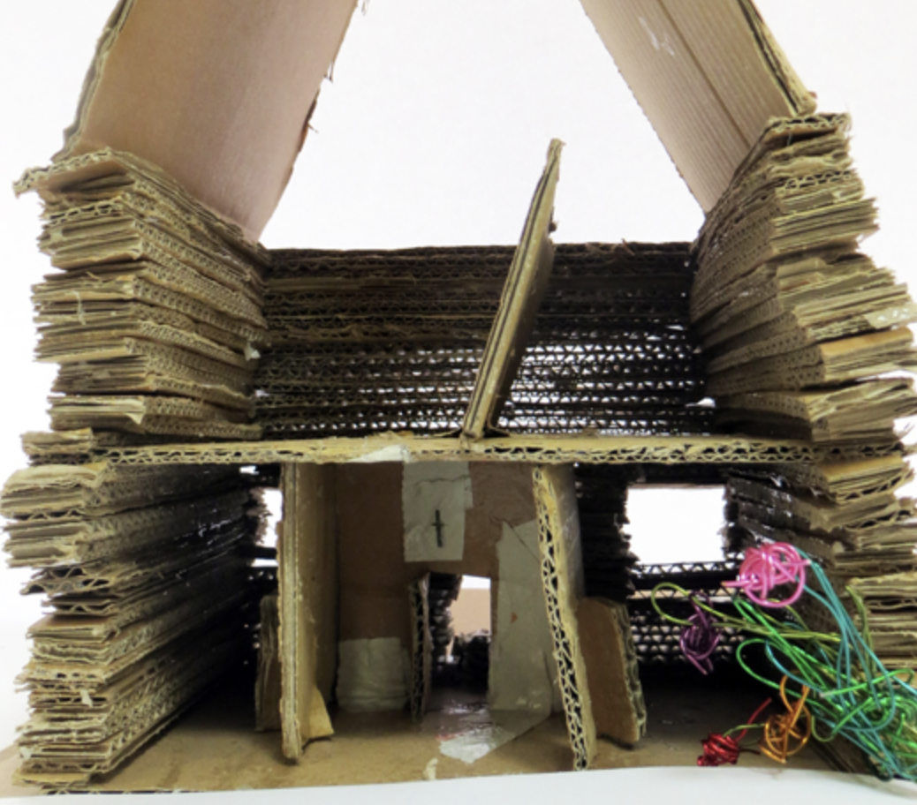
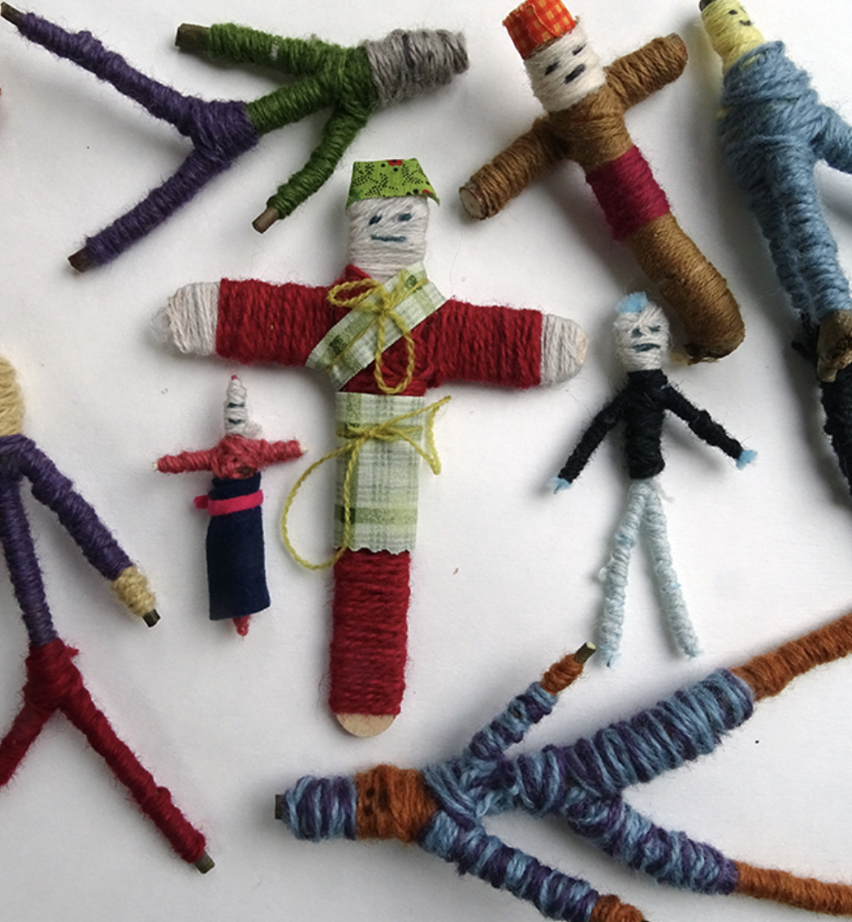
 | Year 2 Making | By the end of Year 2 Children should be able to…
3D, Architecture & Digital Media Explore how 2d can become 3d though “design through making”. Pls see design in the national curriculum Cut simple shapes from card and use them to construct architectural forms. Use drawn, collaged and printed elements as surface decoration for the architectural maquettes. be an architect Use digital media (film and still photos) to create records of models made, including walk-through videos of the inside of the architectural spaces |  | Try out a range of materials & processes and Recognise they have different qualities Use materials purposefully to achieve particular characteristics or qualities Be excited by the potential to create. Understand that art is different to many subjects at school: through art, they can invent and discover Deliberately choose to use particular techniques for a given purpose Develop and exercise some care and control over the range of materials they use

Slide 6
 | Year 2 – Vocab & Assessment Questions | By the end of Year 2 Children should be able to…
Assessment Questions Teachers should consider assessment as a holistic practice, which takes place during every art lesson through conversation with pupils: Tell me about that you are making What might you do next? Which materials might you use? What have you discovered? Tell me about what you have made What would you like to explore more of? Remember! “Creativity is a fragile process that is hard to measure and assess and should always be nurtured and supported”

Slide 7
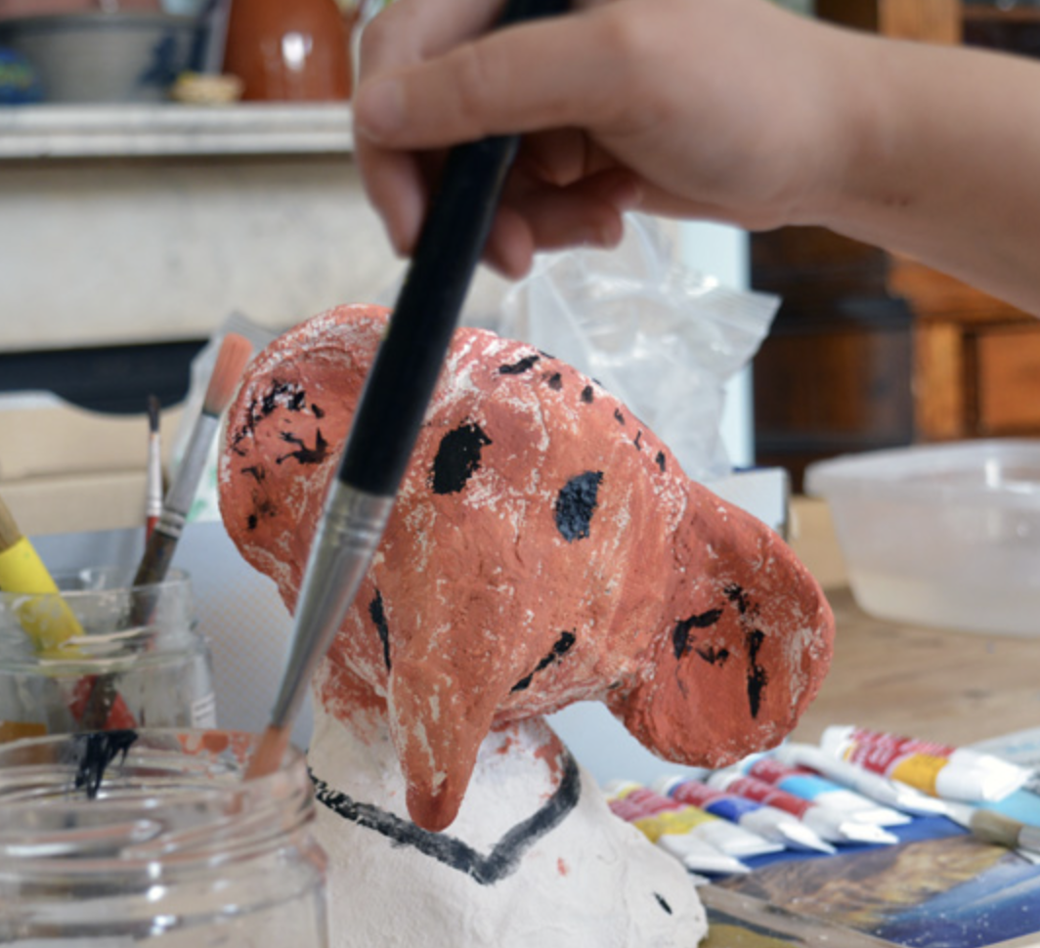
 | Year 3- Generating Ideas | By the end of Year 3 Children should be able to…
Through Making Use growing knowledge of how materials and medium act, to help develop ideas. Continue to generate ideas through space for playful making. Explore how ideas translate and develop through different medium |  | Gather and review information from different sources (primary and secondary), references and resources related to their ideas and intentions Use a sketchbook for different purposes, including recording observations, planning and shaping ideas

Slide 8
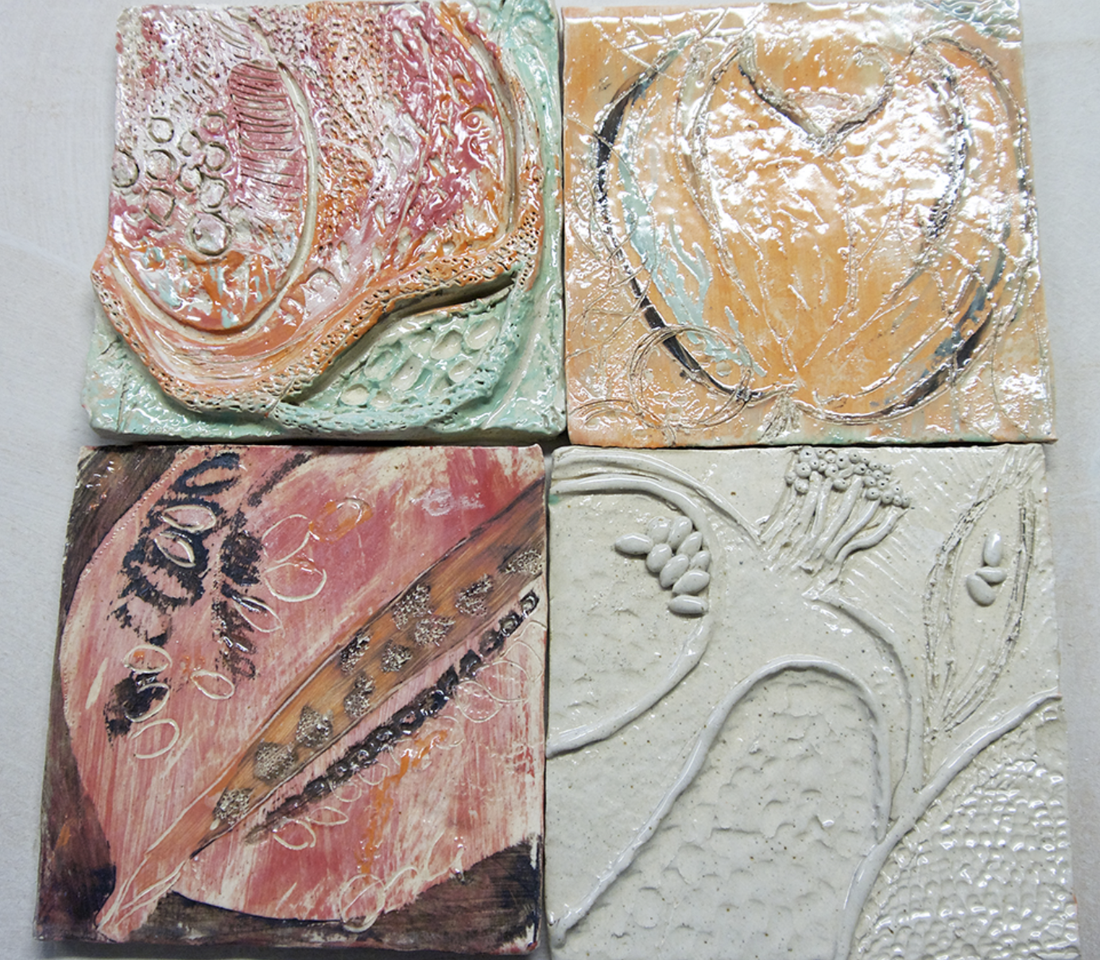
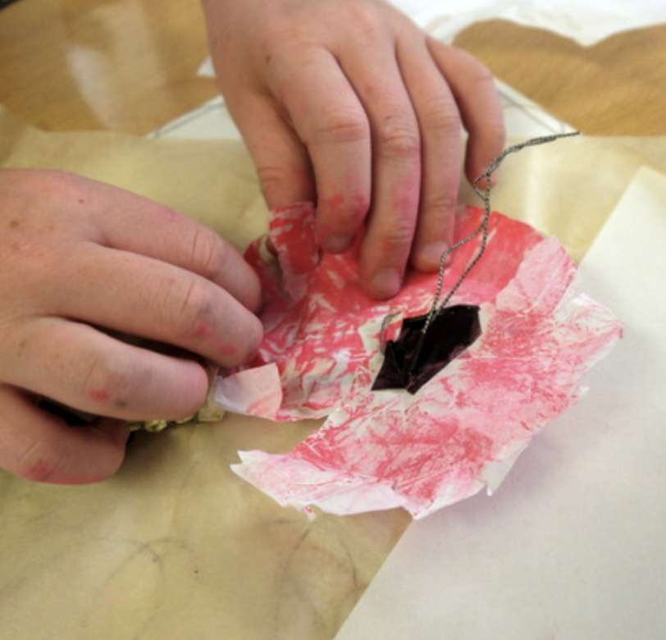
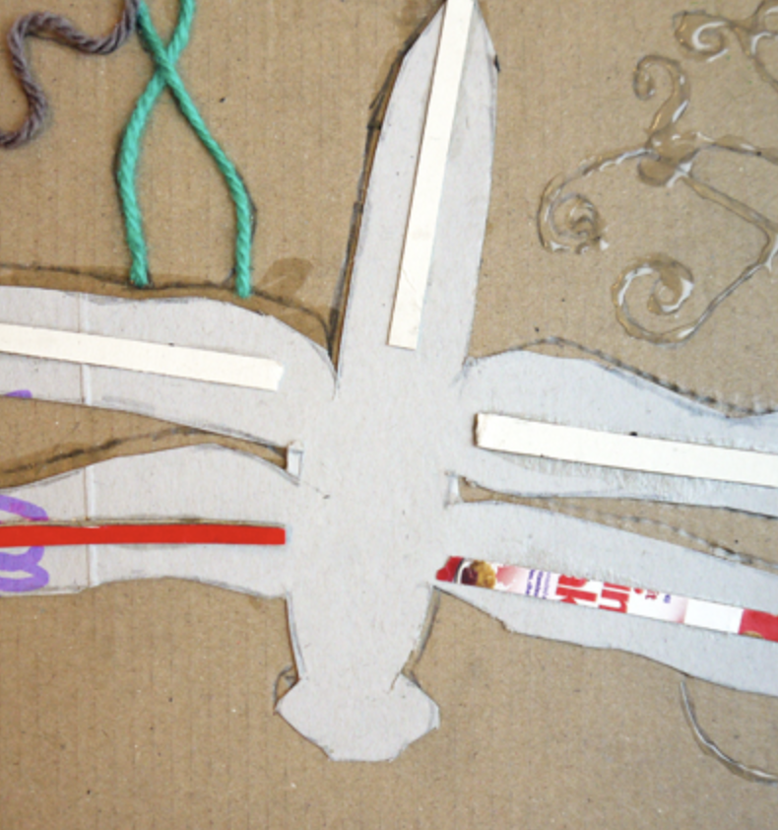
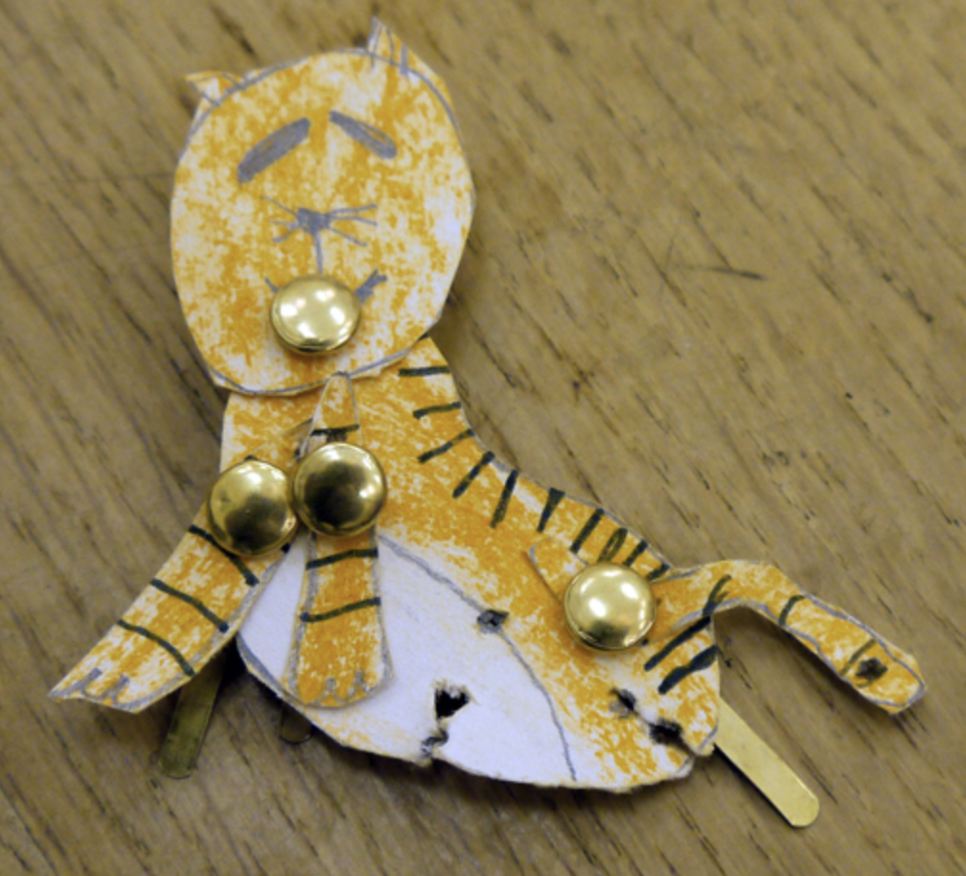
 | Year 3 - Making |  | By the end of Year 3 Children should be able to…
3D Make an armature from paper and tape and use as the basis to explore modelling with Modroc to make sculpture, e.g. Roald Dahl and Quentin Blake sculpture resource Explore a simple clay technique such as making slab pieces, and decorate them relief patterns based upon observational drawing skills, e.g. Clay fruit tiles Explore how combinations of materials such as wire, paper, fabric, string, card can be transformed into sculpture, discovering how best to manipulate them (cut, tear, bend, fold) and fasten them together (tie, bind, stick). Drawing and making flowers Digital & Animation Building on mark-making and observational skills, make drawings of animals, people and vehicles Use scissors to dissect the and reconstruct them into drawings that move, e.g. Making moving drawings Use digital media to make animations from the drawings that move Animating articulated beasts |  |  | Develop practical skills by experimenting with and testing the qualities of a range of materials and techniques Select and use appropriately a variety of materials and techniques in order to create their own work. Be excited by the potential to create and feel empowered to begin to undertake their own exploration

Slide 9
 | Year 3 – Vocab & Assessment Questions | By the end of Year 3 Children should be able to…
Assessment Questions Teachers should consider assessment as a holistic practice, which takes place during every art lesson through conversation with pupils: Tell me about that you are making and what inspired you What might you do next? Tell me about the materials and techniques you are using What have you discovered? How do you feel about the end result? What kinds of problems did you encounter and how did you get round them? Tell me about things you really liked or enjoyed What would you like to explore more of? Remember! “Creativity is a fragile process that is hard to measure and assess and should always be nurtured and supported”

Slide 10
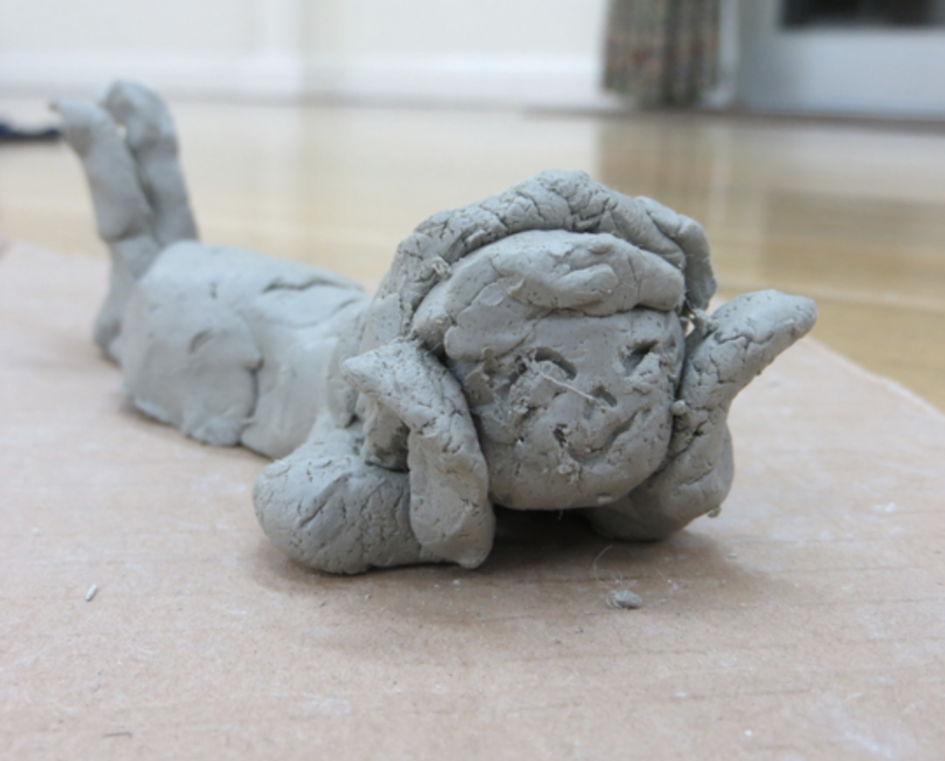
 | Year 4 – Generating Ideas | By the end of Year 4 Children should be able to…
Through Making Use growing knowledge of how materials and medium act, to help develop ideas. Continue to generate ideas through space for playful making. Explore how ideas translate and develop through different medium |  | Use sketchbooks and drawing to purposefully improve understanding, inform ideas and explore potential Understand sketchbooks are places to explore personal creativity, and as such they should be experimental, imperfect, ask questions, demonstrate inquisitive exploration Use sketchbooks, together with other resources, to understand how inspiration can come from many rich and personal sources to feed into creative projects

Slide 11
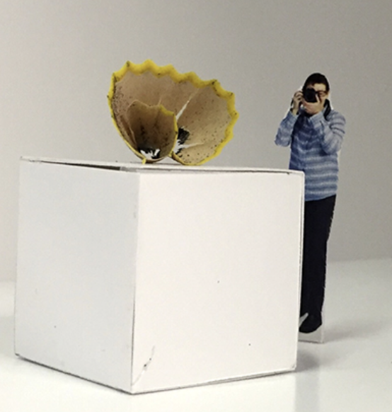
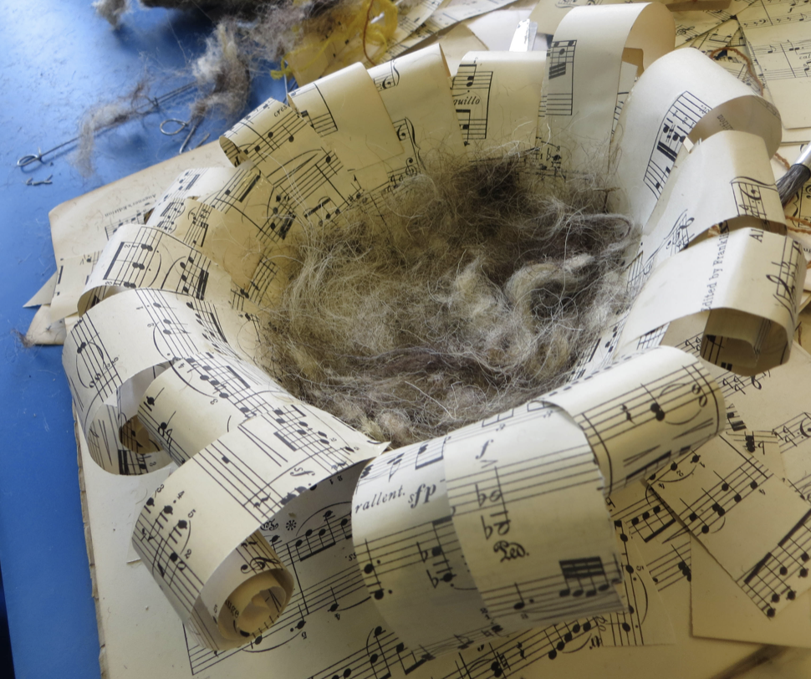
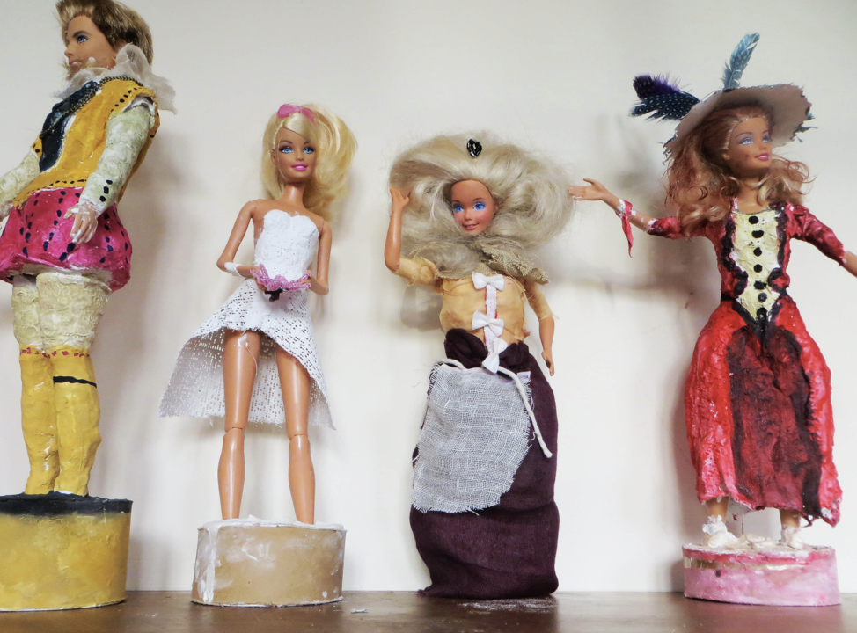
 | Year 4 - Making |  | By the end of Year 4 Children should be able to…
Sculpture Work with a modelling material (clay or plasticine) to create quick 3d figurative sketches from life or imagination. Combine with developing visual literacy skills so that the 3d sketches explore how we read and communicate emotion and idea, e.g. Quick clay figurative sketches Develop visual literacy skills and discover how context and intention can change the meaning of objects, e.g. Making a pocket-gallery Construct with a variety of materials (wool, string, twigs, found objects, paper etc.) exploring how to bring different media together, both technically and visually, e.g. Building_nests Design Develop design through making skills and collaborative working skills through fashion design. Explore paper and card manipulation skills to build 3d forms. Manipulating paper and Pin and paper fashion and Barbie and Ken transformation/ and Paperback figures Extend into an exploration of fabric, deconstructing old clothes and reconstructing elements into new items. e.g. Psyches inspired dress |  |  | Investigate the nature and qualities of different materials and processes Apply technical skills to improve quality of work, combined with beginning to listen and trust “instinct” to help make choices Be excited by the potential to create and feel empowered to undertake their own exploration

Slide 12
 | Year 4 – Vocab & Assessment Questions | By the end of Year 4 Children should be able to…
Assessment Questions Teachers should consider assessment as a holistic practice, which takes place during every art lesson through conversation with pupils: Tell me about that you are making and what inspired you What might you do next? Tell me about the materials and techniques you are using What have you discovered? How do you feel about the end result? What kinds of problems did you encounter and how did you get round them? Tell me about things you really liked or enjoyed What would you like to explore more of? Remember! “Creativity is a fragile process that is hard to measure and assess and should always be nurtured and supported”

Slide 13
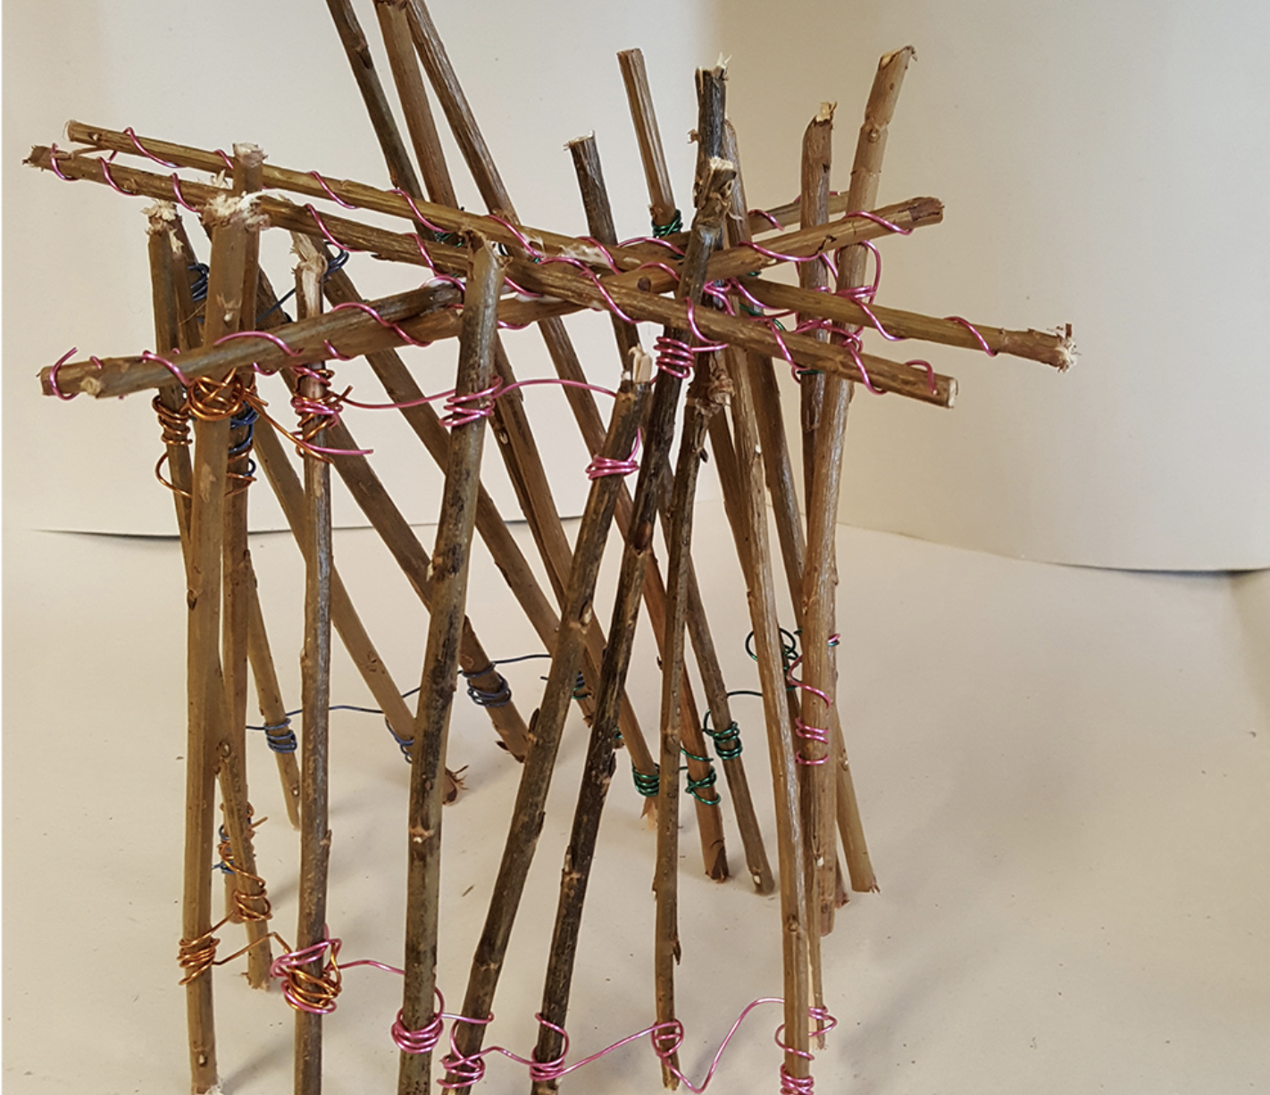
 | Year 5 – Generating Ideas | By the end of Year 5 Children should be able to…
Through Making Use growing knowledge of how materials and medium act, to help develop ideas. Continue to generate ideas through space for playful making. Explore how ideas translate and develop through different medium |  | Engage in open-ended research and exploration to initiate and develop personal ideas Confidently use sketchbooks for a variety of purposes including recording observations, developing ideas, testing materials, planning and recording information Understand sketchbooks are places to explore personal creativity, and as such they should be experimental, imperfect, ask questions, demonstrate inquisitive exploration

Slide 14
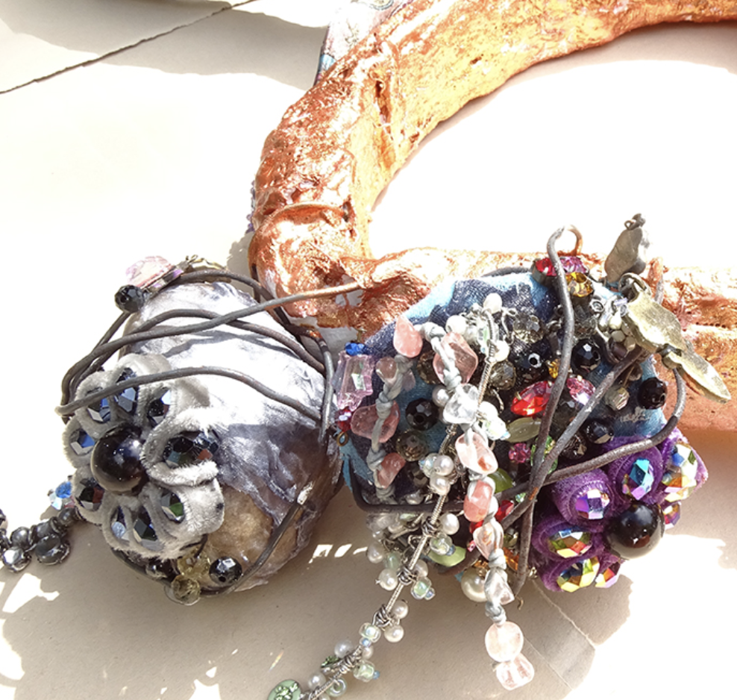
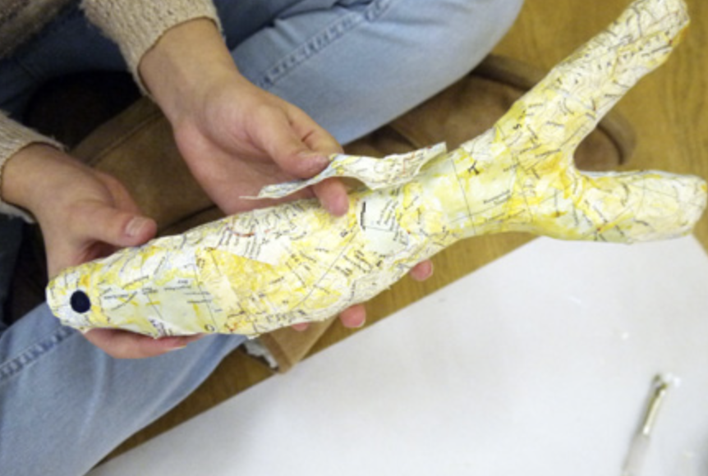
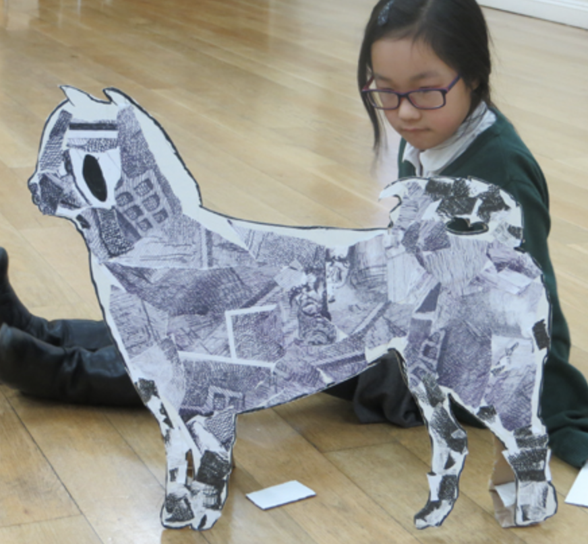
 | Year 5 - Making | By the end of Year 5 Children should be able to…
Architecture & Making Explore architecture of another time and / or culture, and make individual work in response to what is seen. Enable evolution of ideas through a combination of design through making and drawn inspiration. E.g. Architecture and mark making Develop visual literacy skills: explore how we look at and respond to things people have made, and then include this awareness when making sculpture e.g. Inspired by anglo saxon houses Design & Making Explore relationship between sculpture and design through a sketchbook project which takes film/literature/drama as its starting point and facilitates an open-ended sculptural exploration, with children working at their own pace and following their own journey e.g. Developing sketchbook work Enable sketchbook work above to evolve and inform into a sculpture project. Combine and construct with a variety of materials, including modelling and paint, e.g. Supersized jewellery and Fabulous-fish Explore scaling up drawings, bringing in all mark-making skills previously learnt, and using technique to provide opportunity to transform original, e.g. Flat yet sculptural drawing Paint on new surfaces (e.g. stone, fabric, walls, floors and work collaboratively to produce images in new contexts, e.g Communal summer picnic drawing orTreasured fossils |  | Confidently investigate and explore new materials, beginning to lead their own search for new experiences Use acquired technical expertise, combined with beginning to listen and trust “instinct” to help make choices, to make work which effectively reflects ideas and intentions Feel safe enough to take creative risks

Slide 15
 | Year 5 – Vocab & Assessment Questions | By the end of Year 5 Children should be able to…
Assessment Questions Teachers should consider assessment as a holistic practice, which takes place during every art lesson through conversation with pupils: Tell me about that you are making and what inspired you What might you do next? Tell me about the materials and techniques you are using What have you discovered? How do you feel about the end result? What kinds of problems did you encounter and how did you get round them? Tell me about things you really liked or enjoyed What would you like to explore more of? What is the potential of what you have done? What could you do next? Remember! “Creativity is a fragile process that is hard to measure and assess and should always be nurtured and supported”

Slide 16
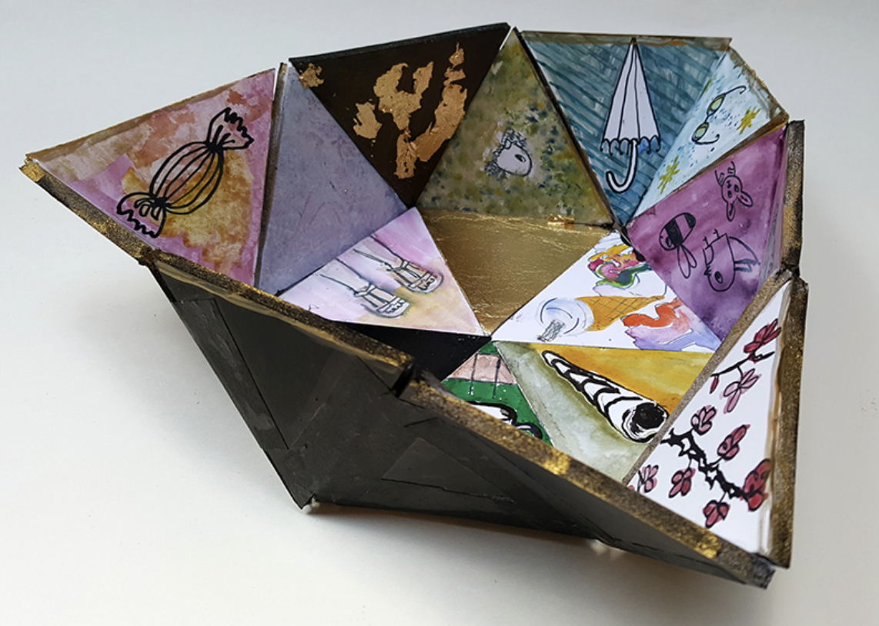
 | Year 6 – Generating Ideas | By the end of Year 6 Children should be able to…
Through Making Use growing knowledge of how materials and medium act, to help develop ideas. Continue to generate ideas through space for playful making. Explore how ideas translate and develop through different medium |  | Independently develop a range of ideas which show curiosity, imagination and originality Investigate, research and test ideas and plans using sketchbooks and other approaches Understand sketchbooks are places to explore personal creativity, and as such they should be experimental, imperfect, ask questions, demonstrate inquisitive exploration

Slide 17
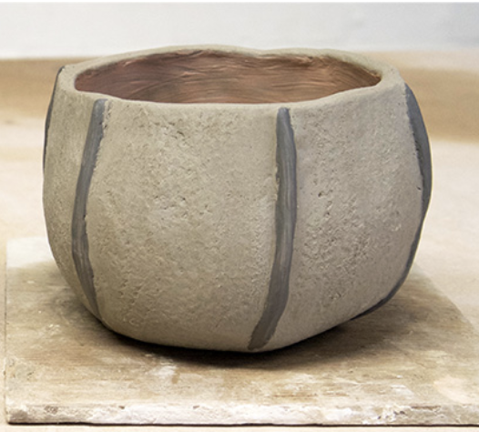
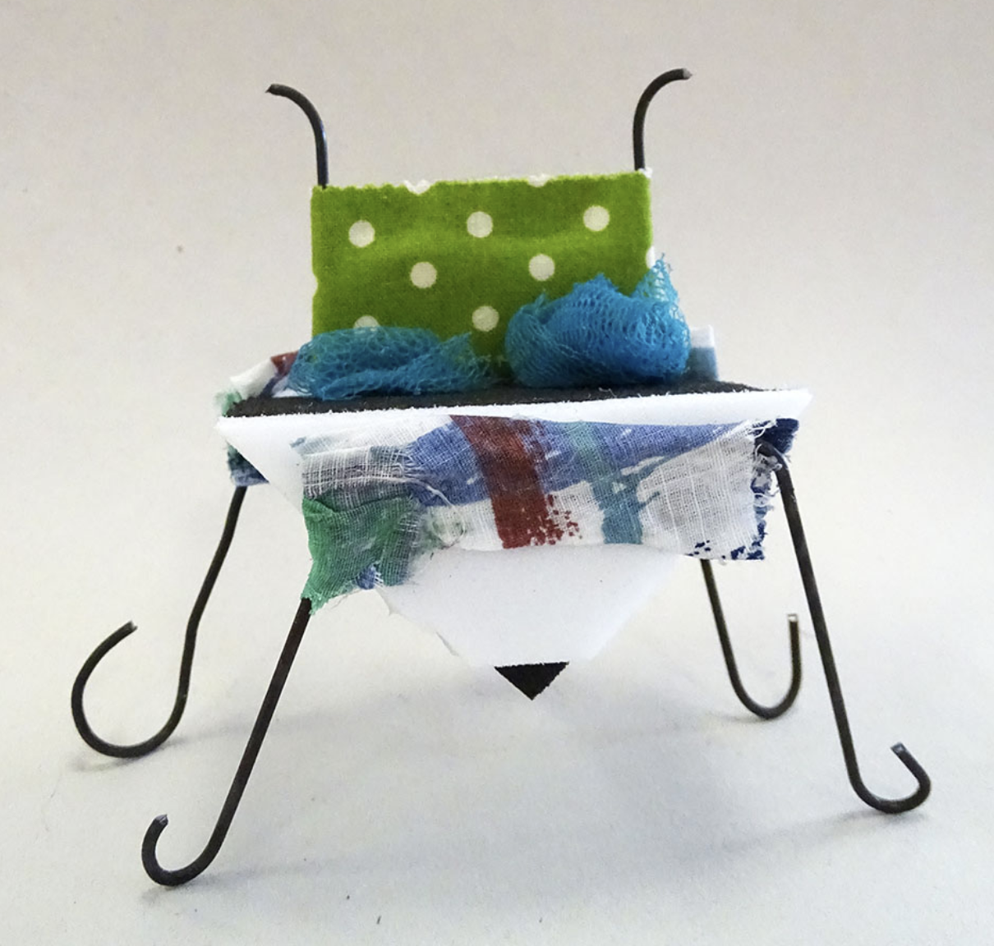
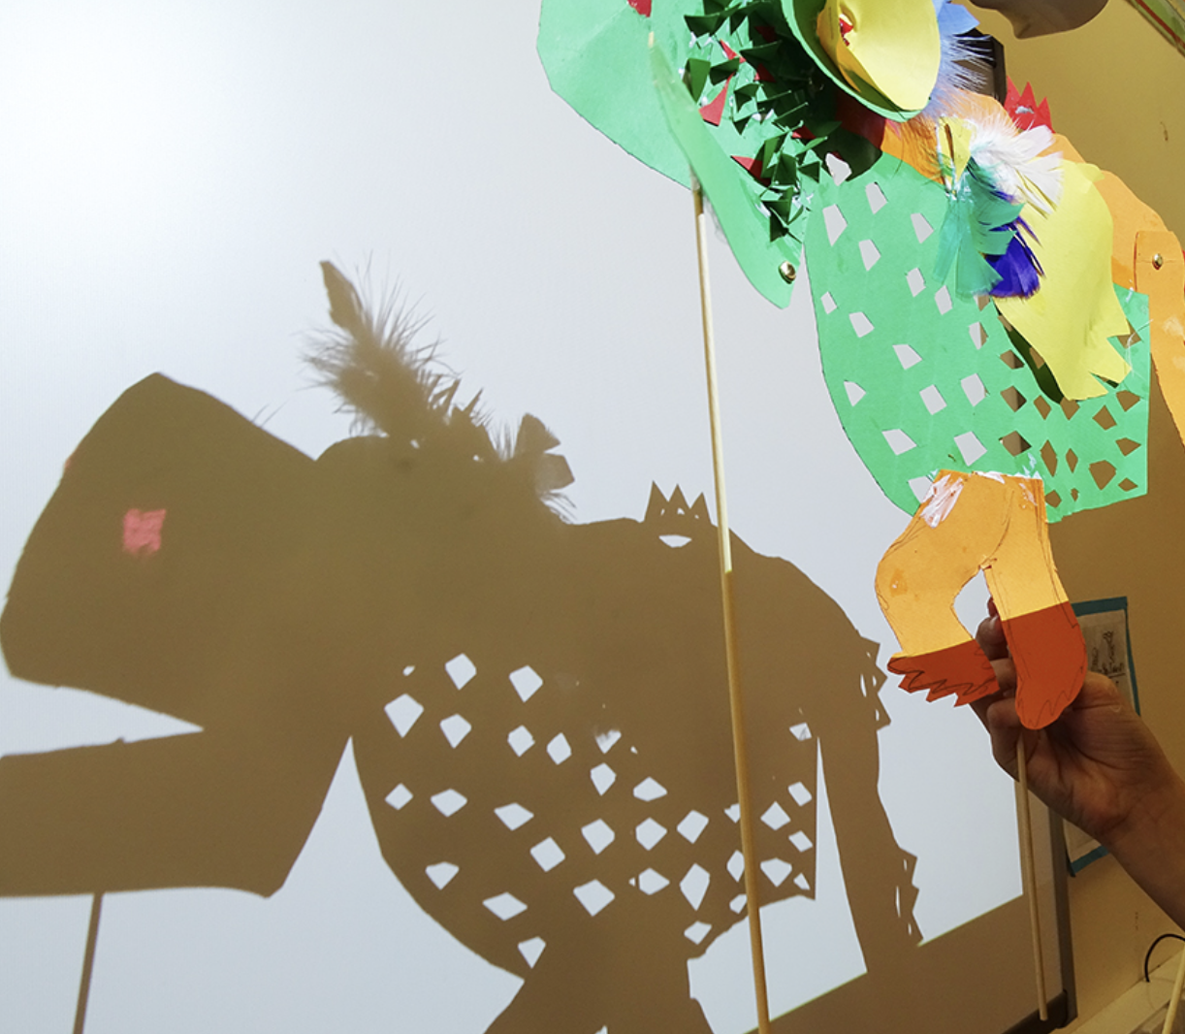
 | Year 6 - Making | By the end of Year 6 Children should be able to…
Mark Making & Making Develop clay (and drawing) skills by creating pinch pots based upon still life observation, e.g. Fruit pinch pots Explore geometric design/pattern / structure, e.g. Wave bowls Puppetry Develop drawing and making skills and combine with narrative/character development and make puppets. Using tools to cut intricate shapes and use fastenings to create moving parts. Work collaboratively to perform, and use digital media to record e.g. Shadow puppets and whiteboards and Shadow puppet play Design & Making Explore set design using mixed media and linking literature, drama, music and design, e.g. Set design with primary children Explore transformation of materials following own journey to produce an object which conveys personality of maker/designer, e.g. Making Seats |  | Independently take action to refine technical and craft skills to improve mastery of materials and techniques Confidently follow intuition and instinct during the making process, making intelligent and confident creative choices Independently select and effectively use relevant processes in order to create successful and finished work Feel safe enough to take creative risks, enjoying the journey

Slide 18
 | Year 6 – Vocab & Assessment Questions | By the end of Year 6 Children should be able to…
Assessment Questions Teachers should consider assessment as a holistic practice, which takes place during every art lesson through conversation with pupils: Tell me about that you are making and what inspired you What might you do next? Tell me about the materials and techniques you are using What have you discovered? How do you feel about the end result? What kinds of problems did you encounter and how did you get round them? Tell me about things you really liked or enjoyed What would you like to explore more of? What is the potential of what you have done? What could you do next? Remember! “Creativity is a fragile process that is hard to measure and assess and should always be nurtured and supported”

