Slide 1

An Introduction to AccessArt

Slide 2
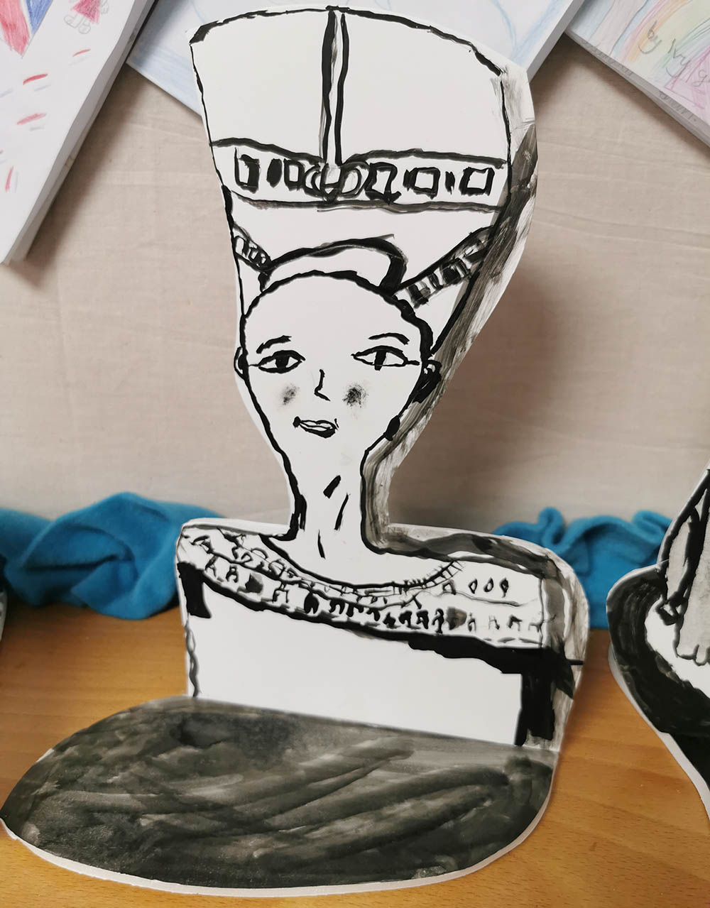
Aims
To introduce you to the AccessArt Primary Art Curriculum
To see how the curriculum will impact both teachers and pupils
To consider how we will implement it in our teaching

Slide 3
Introduction:
Why We Are Using AccessArt In Our School

Slide 4
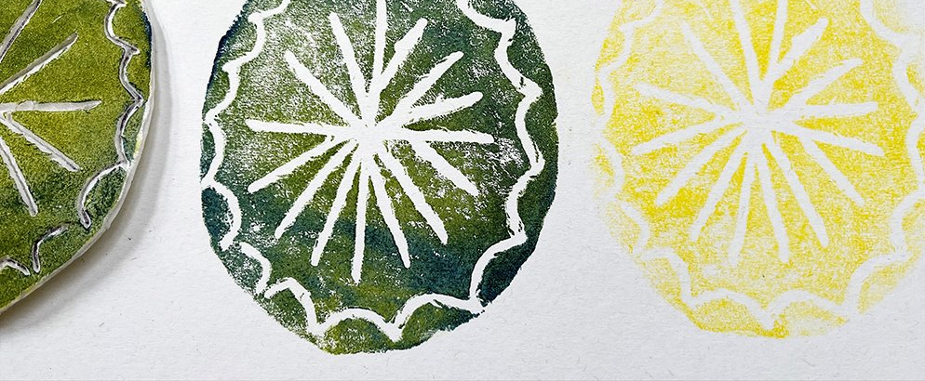
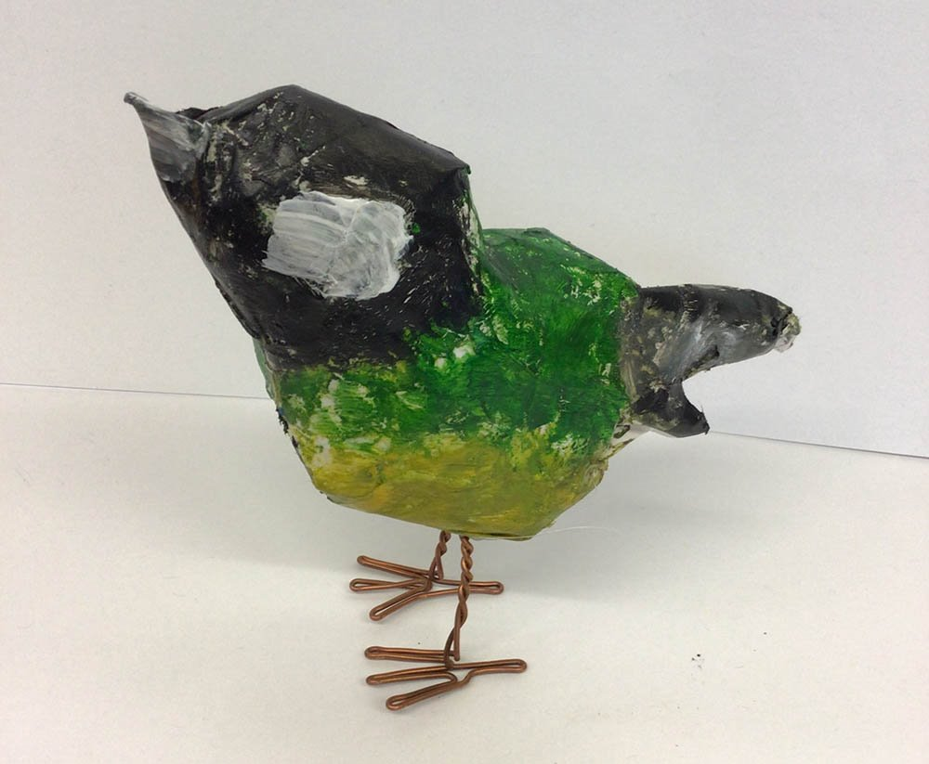
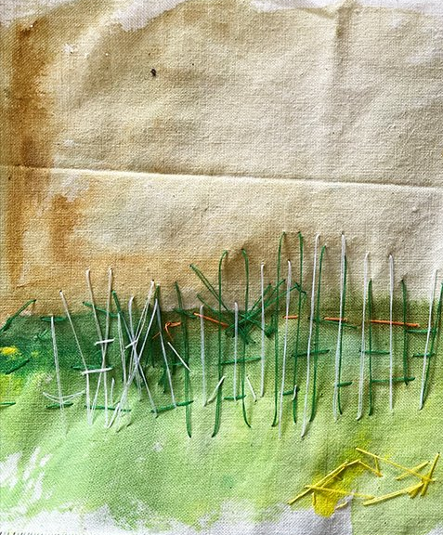
It will provide us with a rich and diverse curriculum
It will provide a clear structure to explore and teach art
It is flexible so we can tailor and adapt it
There are supporting docs which we can adapt
Why have we chosen the AccessArt Primary Art Curriculum for our school?
It will build teacher confidence and enthusiasm – Zoom CPD and recorded sessions to support teachers
Pupils will have a range of experience with individual and personal outcomes
Knowledge, skills, enthusiasm, confidence amongst pupils will grow
You will feel more connected to your own creativity, experiencing new materials and techniques alongside your pupils

Slide 5
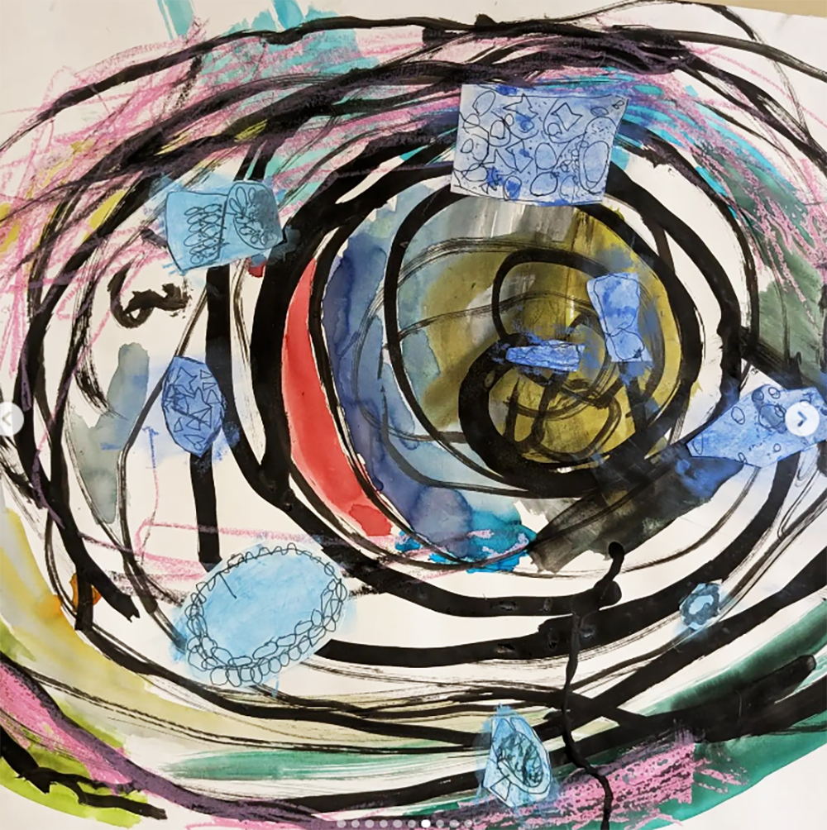
Enable an exploratory, open-ended creative journey
Our Aims
Introduce many disciplines and show how they are connected/unique
To ensure by the end of Yr 6 all pupils have found an aspect of art (making, looking, talking) that they feel like they can enjoy and excel at.
To help pupils understand the purposes of art, both to them as individuals and as society.
Explore a diverse and contemporary range of artists
Ensure the journey is varied, relevant and engaging
Diverse and individual experiences & outcomes
Ruth at Carden Primary School

Slide 6
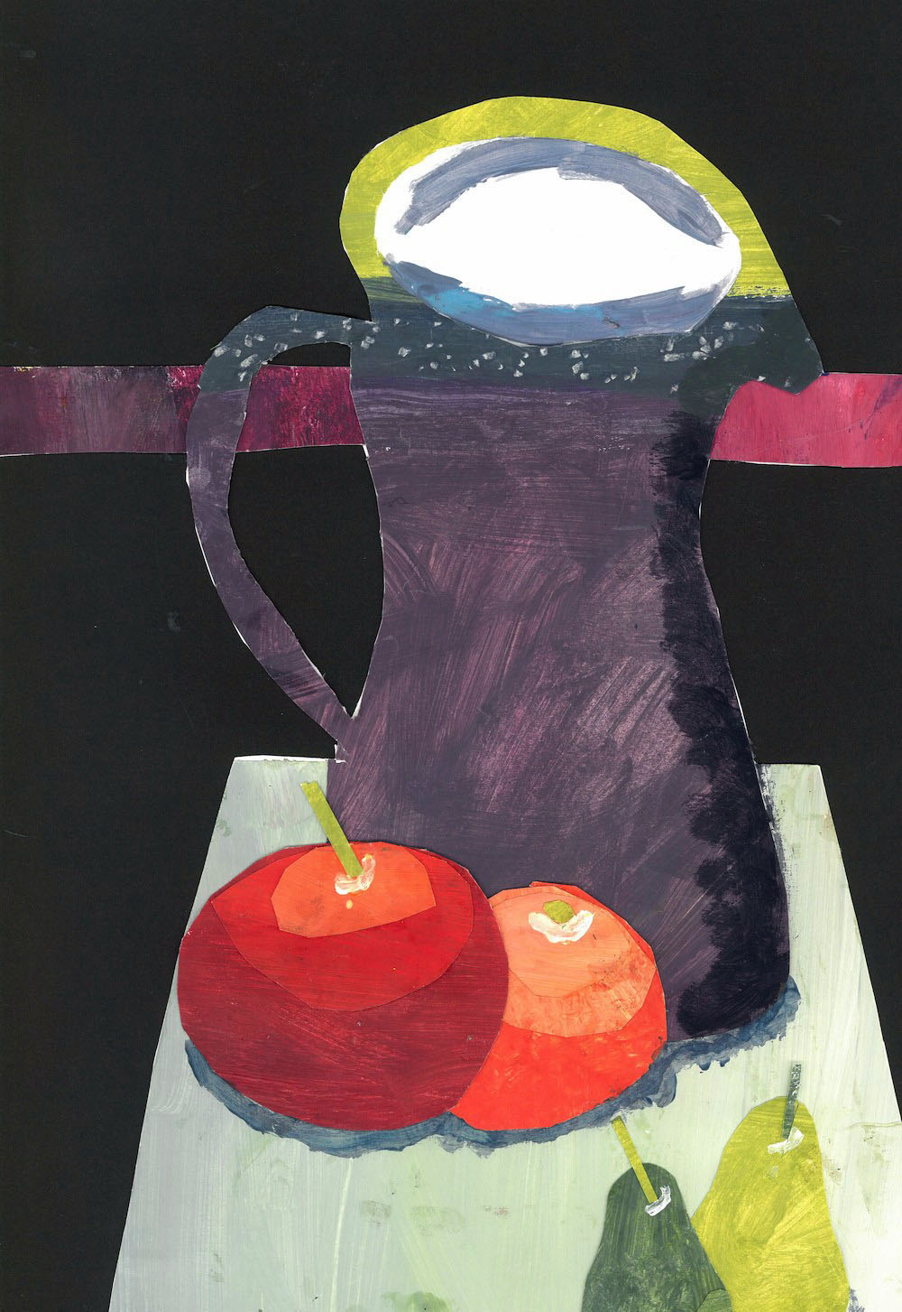
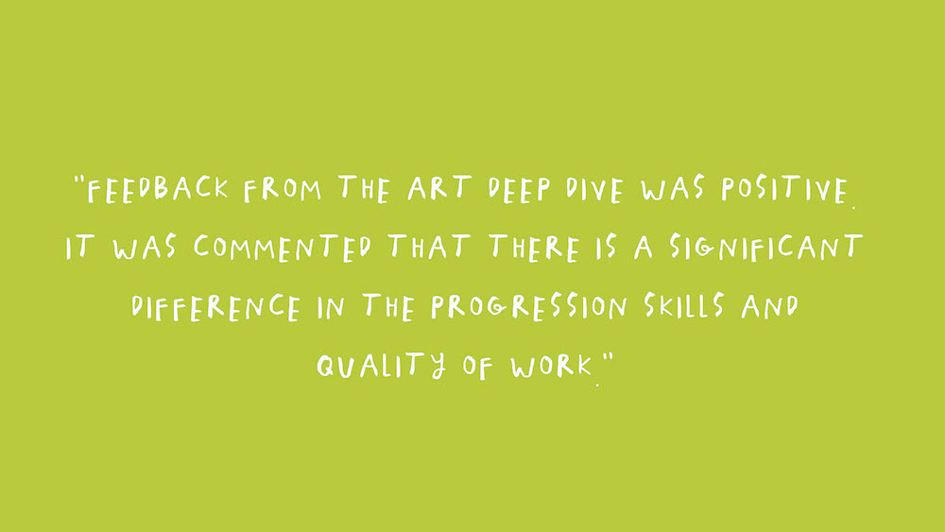
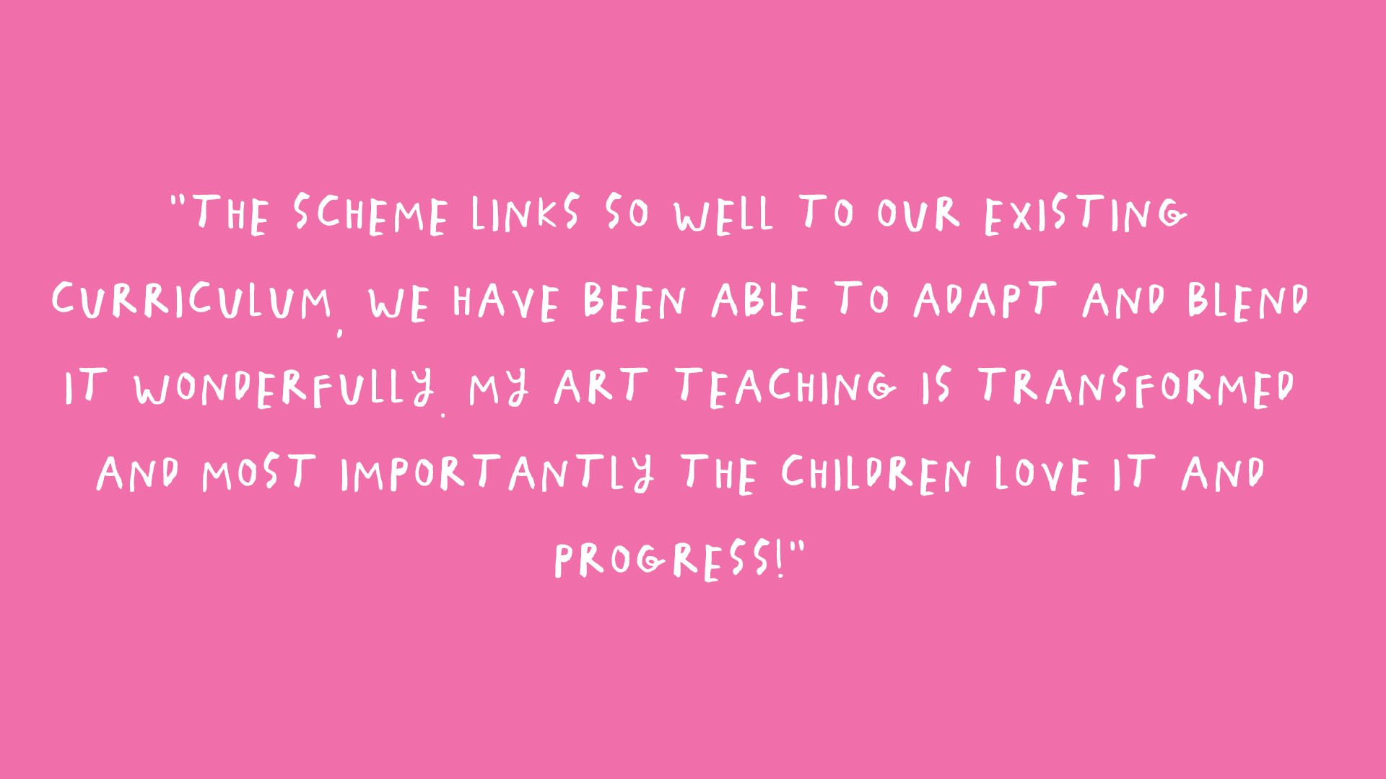
What Teachers Think…
Over 67% of teachers who responded who have used AccessArt Primary Art Curriculum for a term or more, feel that their visual art curriculum is now more diverse, contemporary and relevant.
Over 66% of teachers feel that they now have a clear structure from which to explore art, and that they understand how their teaching fitted into the bigger picture in school.
62% of teachers have a better understanding of the importance of an open-ended exploratory approach and how to enable this kind of learning.*
*Statistics and Quotes taken from User Survey Report October 2023
Year 6, Sheffield High School

Slide 7
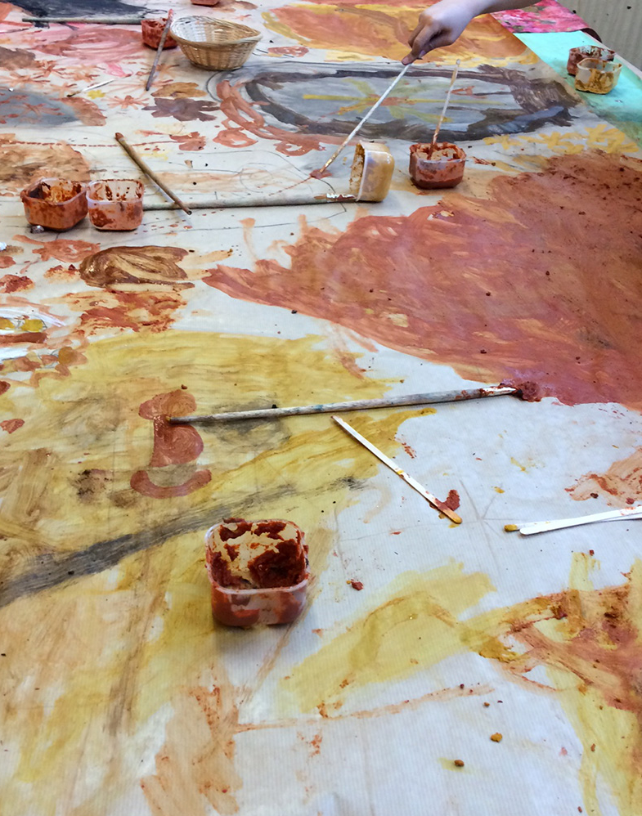
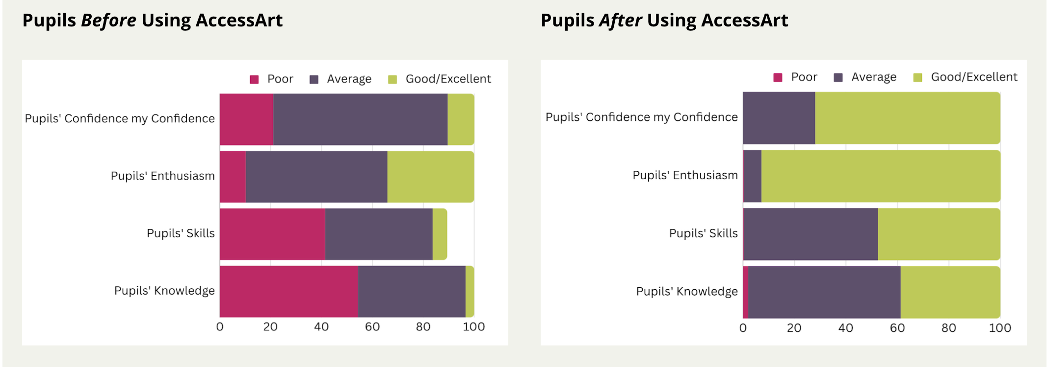
Teachers reported the following behaviours had been developed through Curriculum use:
Impact on Children
Enjoyment of Exploring 92.8%
Teachers who have been using the curriculum for at least one term or more have seen large increases in confidence, enthusiasm, skills and knowledge from the children.
Willingness to Take Creative Risks 82.1%
Pleasure in Discovery 60.1%
Pupils' Confidence
Pupils' Confidence
Sharing Ideas 60.7%
Statistics taken from User Survey Report October 2023

Slide 8
To Do:
Take a look at the AccessArt Impact & Evidence Report

Slide 9
The Structure of the Curriculum

Slide 10
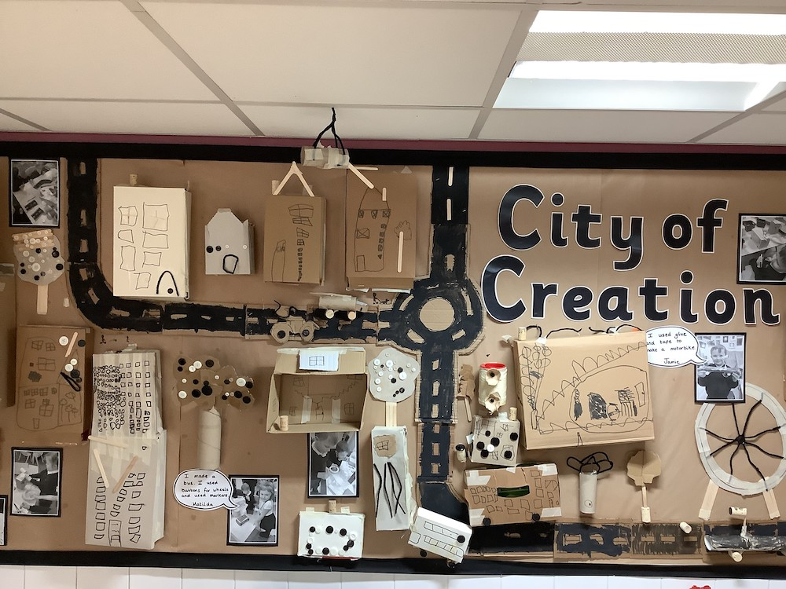
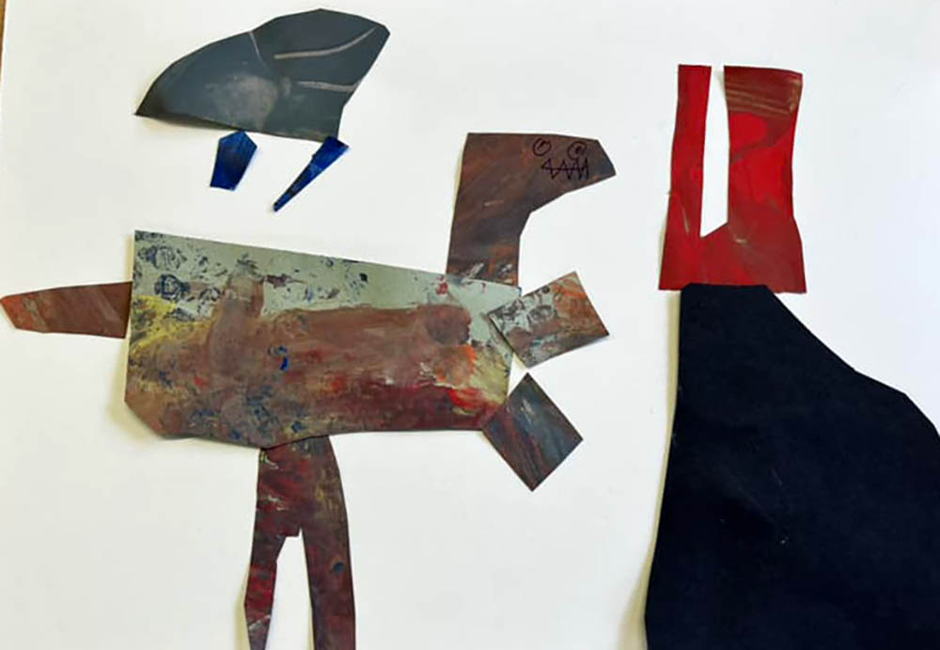
EYFS
Our children in EYFS will explore activities across 7 areas in the AccessArt EYFS resources.
You can choose the activities based on what you think your children would enjoy, and what you would like to facilitate too! There is no set order of activities, just ensure you balance 3D making with 2D (drawing, painting, printing).
How Can We Explore 3D Materials?
How Can We Explore Colour?
How Can We Use Our Imaginations?
How Can We Build Worlds?
How Can We Use Our Bodies To Make Art?
How Can We Explore Materials and Marks?
What Can We See?
EYFS, St Michaels Community Academy
Reception / Year 1 Chilthorne Domer Church School

Slide 11
Art Lead Note:
Delete the following slides so you are left with the curriculum version you are following in your school…

Slide 12
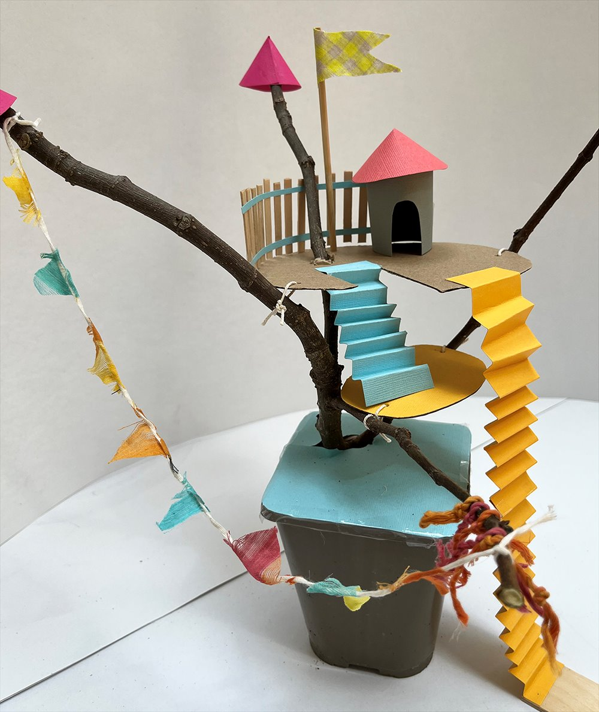
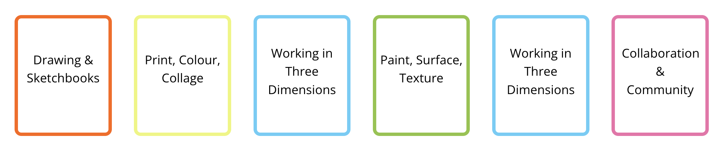
Full Curriculum
We are following the full curriculum which consists of 36 “pathways”. Each pathway covers teaching across a half term.
Across the year, your pupils will experience the following disciplines...
See the Full Curriculum
The curriculum is adaptable and flexible which gives us the opportunity to move around the order in which the pathways are taught (for example if you are teaching by curriculum topic).
Each pathway comes with supporting documents and videos to build our confidence and knowledge.

Slide 13
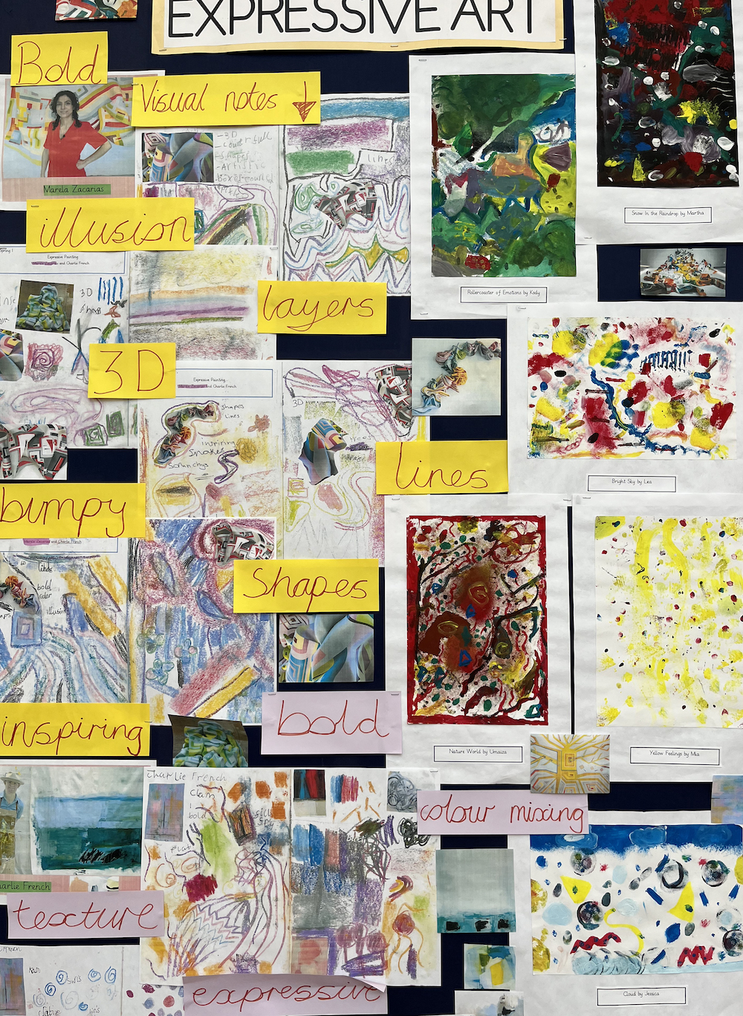
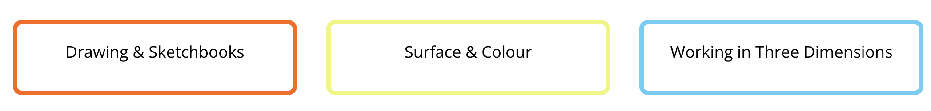
Split Curriculum
We are following the split curriculum so that we can alternate with DT. The split curriculum consists of 3 “pathways" for each year group. The following disciplines ensure that your pupils are balancing 2D and 3D making.
See the Split Curriculum
Within each discipline there is a choice of pathways, we have chosen the pathways we will be using.
You can find drawing exercises for DT half terms to ensure that pupils are keeping up with their drawing and sketchbook work.
The split curriculum comes with supporting documents and videos to build our confidence and these helped us to make choices about the pathways we'll be teaching.

Slide 14
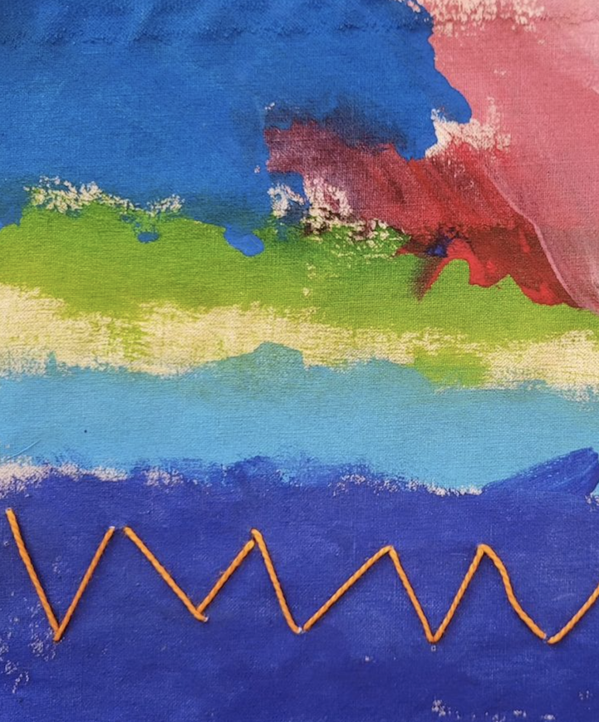
Mixed Curriculum
We are following the mixed curriculum catering for mixed year groups.
Each year consists of six “pathways” , one for each half term. Across each year pupils will experience the following disciplines...
See the Mixed Curriculum
Note: Because progress in art isn't linear, you can be reassured when adapting the rolling year groups that children don't need to experience a step-by step approach in developing art skills. Each child will begin working at their own level in whatever exercise you give them and what they take from it will be valuable, no matter the age.
The mixed curriculum comes with supporting documents and videos to help us understand how to adapt the mixed curriculum for different year groupings. You can also email AccessArt for advice.
Year 3, Goose Green Primary School

Slide 15
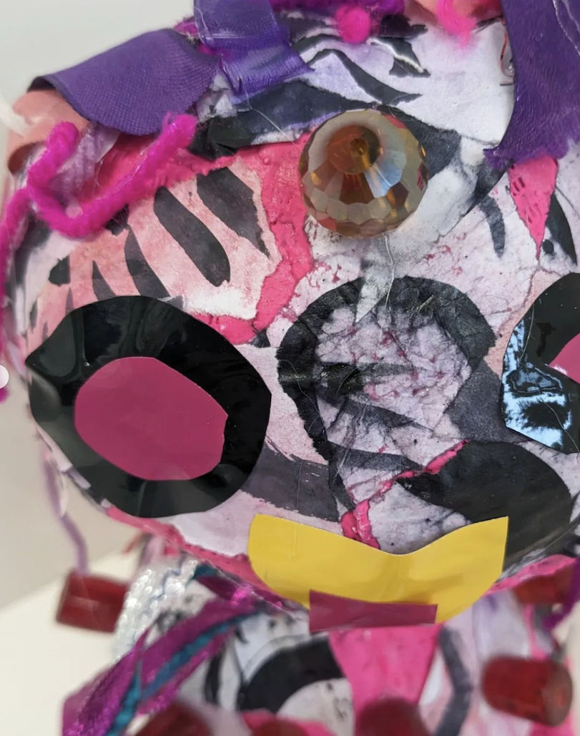
Mixed and Split Curriculum
We are following the split and mixed curriculum which consists of 3 “pathways". The EYFS resources are useful if you have complex mixed classes in KS1.
Across each year pupils will experience the following disciplines...
See the Mixed & Split Curriculum
The Split and Mixed curriculum comes with supporting documents and videos to build confidence and help you make choices about the pathways you pick.
Because progress in art isn't linear, you can be reassured when adapting the rolling year groups that children don't need to experience a step-by step approach in developing art skills. Each child will begin working at their own level in whatever exercise you give them and what they take from it will be valuable, no matter the age.
You can also find drawing exercises for DT half terms to ensure that pupils are keeping up with their drawing and sketchbook work.
Year 1, Ruth at Carden Primary School

Slide 16
To Do:
Familiarise yourself with the structure of your chosen curriculum.
Explore the supporting documents and watch the relevant supporting videos.

Slide 17
The Pathways

Slide 18
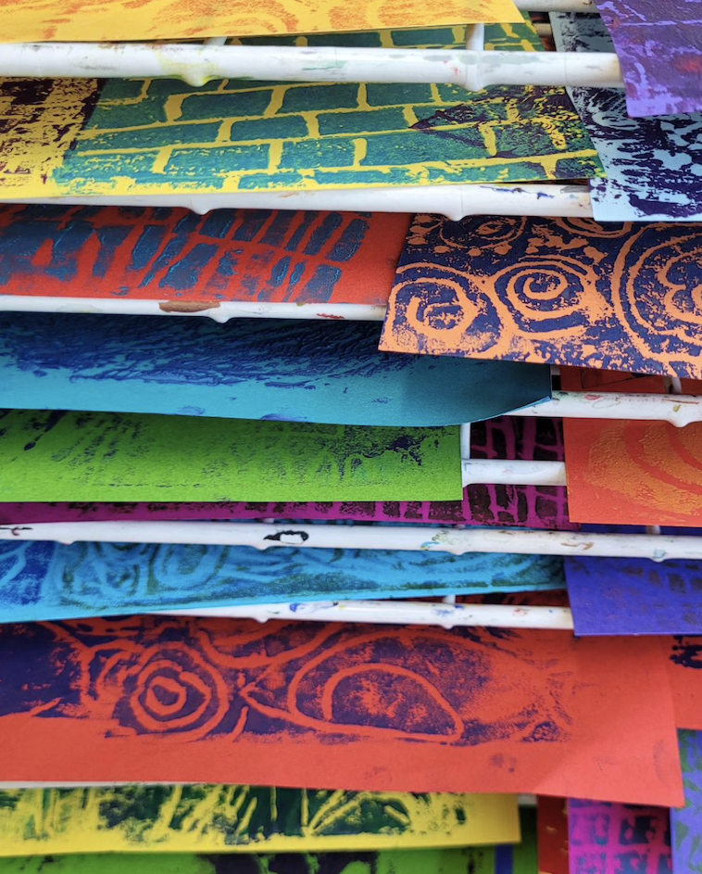

What is a Pathway?
A pathway is a collection of activities to cover half a term, based around a particular theme or discipline.
Pathways are grouped into categories (opposite).
Pathways are designed to contain a variety of activities to keep children engaged and to aid creative thinking.
Most pathways can be expanded or shortened as required.
Pathways contain links to other resources (i.e. Talking Points, or activity-based resources which will enable your classroom teaching
Each pathway follows a particular format:
Artists: Materials: Activity: Crit / Reflection
Challenge or Brief: Artists: Activity: Crit / Reflection
Warm-Up: Artists: Activity: Crit / Reflection
Year 2, Goose Green Primary School

Slide 19
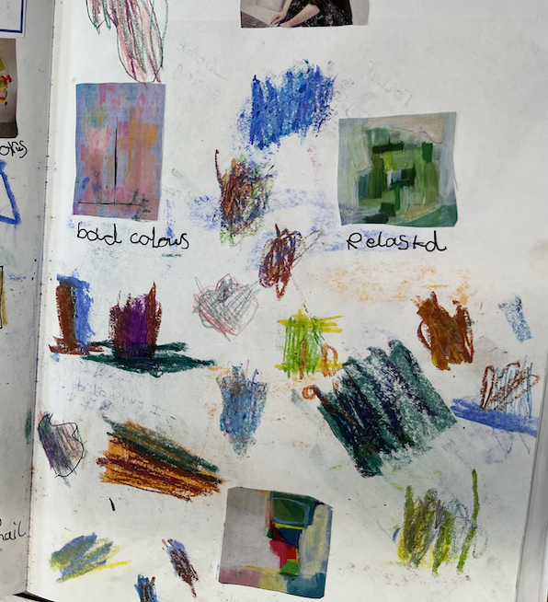
Talking Points
Each Talking Points is formed of videos/images of artists work with questions which prompt class discussion.
The Talking Points aim to encourage you and your pupils to explore and talk about different aspects of the visual arts.
AccessArt has provided a diverse range of artists/craftspeople/designers and architects across the curriculum to help introduce an artist or concept in each pathway.
You might find a Talking Points at the beginning of a pathway to help introduce children to the topic, or they might be used halfway through a pathway to give your pupils some fresh inspiration and energy.
AccessArt encourages sketchbook exercises such as Visual Notes or Show Me What You See as children are watching videos or looking at artists work, to help them slow down and process what they are seeing/hearing. These notes are also useful to refer back to throughout the pathway.

Slide 20
To Do:
Familiarise yourself with the pathways you will use.
Explore the Talking Points resources.

Slide 21
Key Skills

Slide 22
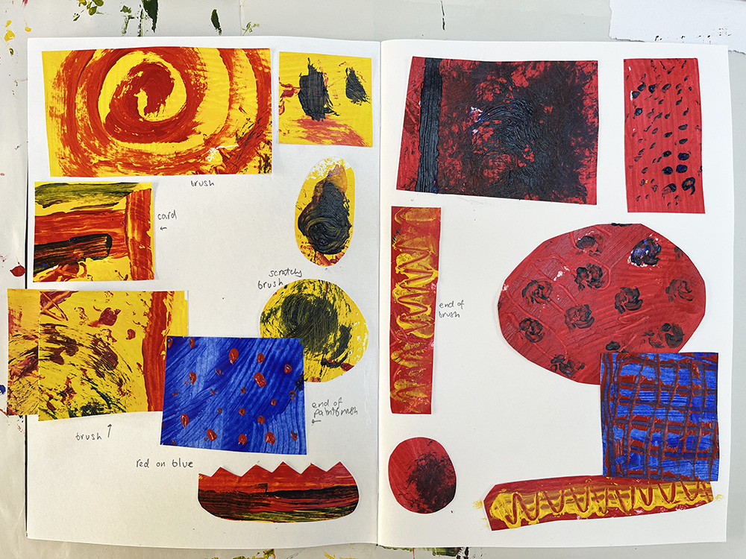
Sketchbooks
Embedding sketchbook work throughout the year, across all year groups, will ensure our pupils develop key skills in experimenting, recording, failing, reflecting and understanding.
Find the AccessArt
Sketchbook Journey

Slide 23
To Do:
Broaden your understanding of sketchbooks with some of the following articles found in the Sketchbook Journey:
What are sketchbooks?
Sketchbook Activity, Behaviors and Skills
Key differences between sketchbooks and exercise books

Slide 24
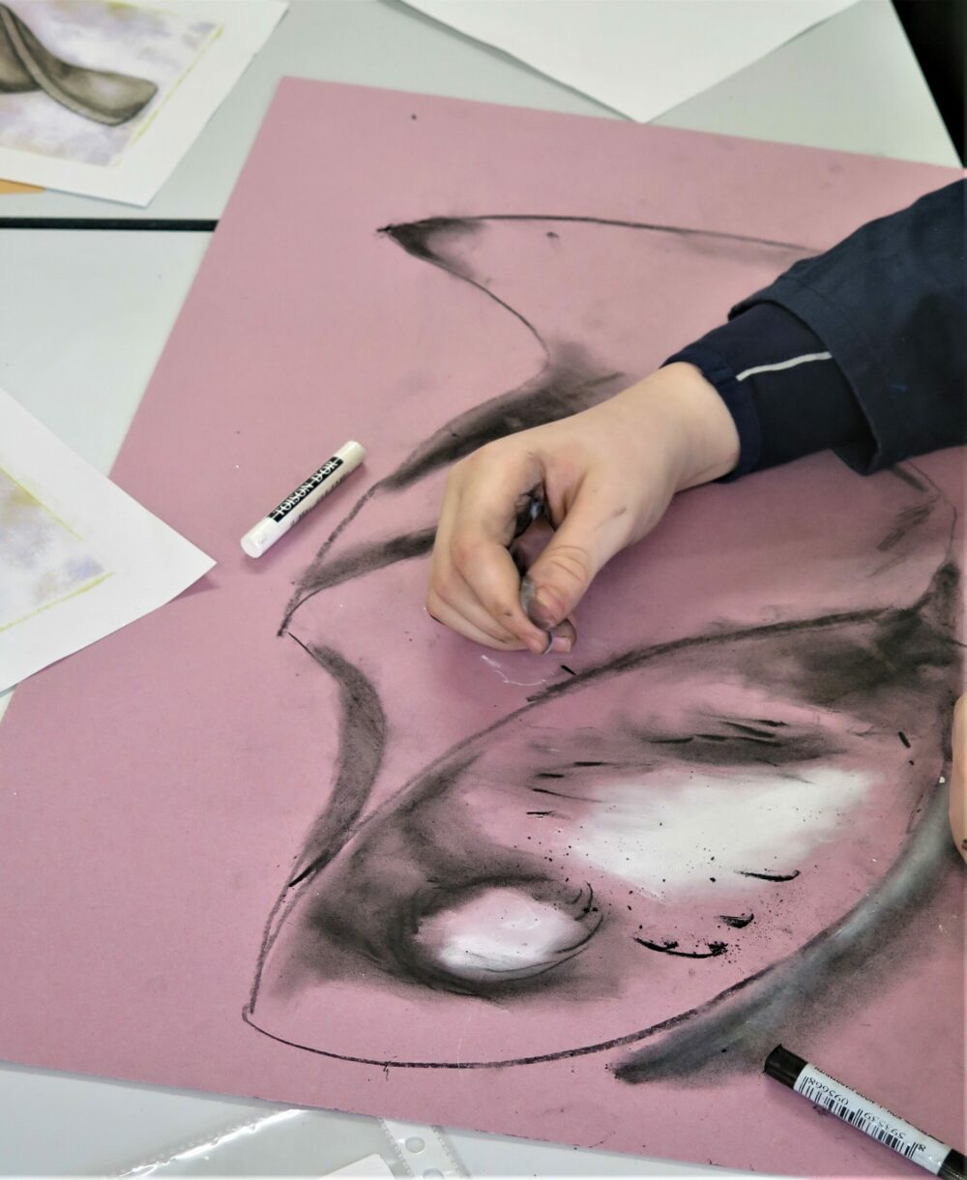
Drawing
Drawing can be found across all pathways in the form of warm-up activities and exercises to help our pupils consolidate learning. We need to try to ensure that our pupils are...
Drawing Journey
Provided with varied drawing materials from the beginning.
Drawing exercises for DT half term
Working in a variety of scales on different drawing materials.
Balancing observation, with more experimental drawing skills.

Slide 25
To Do:
Familiarise yourself with some drawing pedagogy resources.

Slide 26
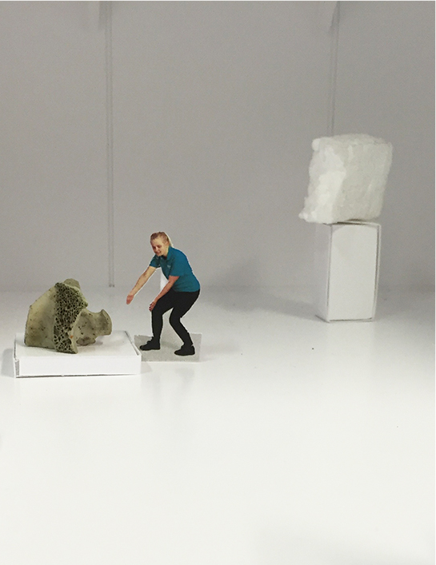
Oracy and Reflection
At the end of every pathway, we'll carve out some time for reflection. In this session our pupils will talk about their artwork, listen to and contribute to feedback.
The room can be set up as a 'gallery' space with work made throughout the half term displayed on their tables.
You might like to see how to run a class crit

Slide 27
To Do:
Watch the CPD session recording of how to run a class crit.

Slide 28
Assessment

Slide 29
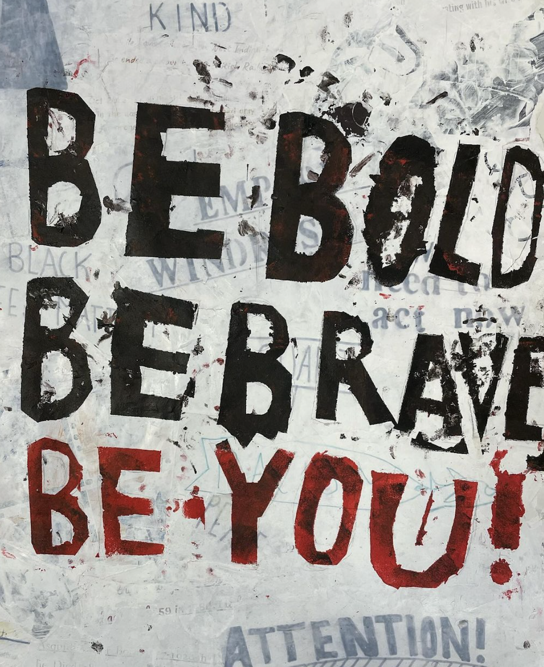
Assessment and Pedagogy
Art is unique! When we assess our pupils consider...
Keeping it light and celebratory! Creativity is fragile and we want our pupils to feel empowered by it.
Thinking holistically! Lots of different types of learning take place through art so it's important that we don't just rely on measurement of certain skills (such as technical skills) above all other skills.
AccessArt has a few suggestions for how to record progression such as using circle diagrams.
You might like to explore what AccessArt says about Assessment and Progression Pedagogy
Jo Wilson and Beecroft Garden Primary School

Slide 30
To Do:
Watch 'How do we assess creativity?'
Watch 'Thinking about curriculum content and progression in Primary Art'

Slide 31
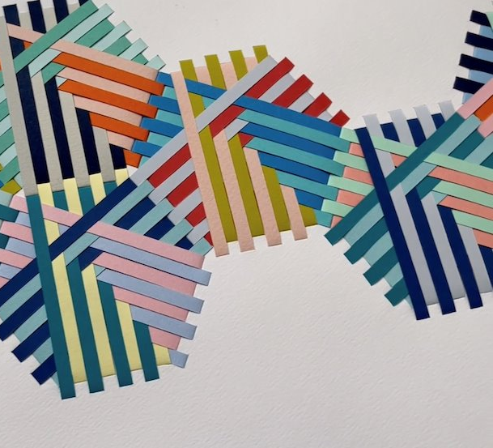
CPD
To build your confidence in teaching art you might like to attend some free online CPD.
AccessArt provides free twilight Zoom CPD which introduces you to...
The curriculum
Pedagogical approaches
Practical aspects of teaching art
If you can't make it to the twilight sessions, you can watch it back on their library of recordings of past Zoom CPD…
You might like to sign up to an upcoming CPD session
Access Recordings of past CPD here

Slide 32
To Do:
Watch a CPD recording of a past session relating to a pathway you're teaching soon...or a recording exploring a technique you don't feel confident teaching.

Slide 33
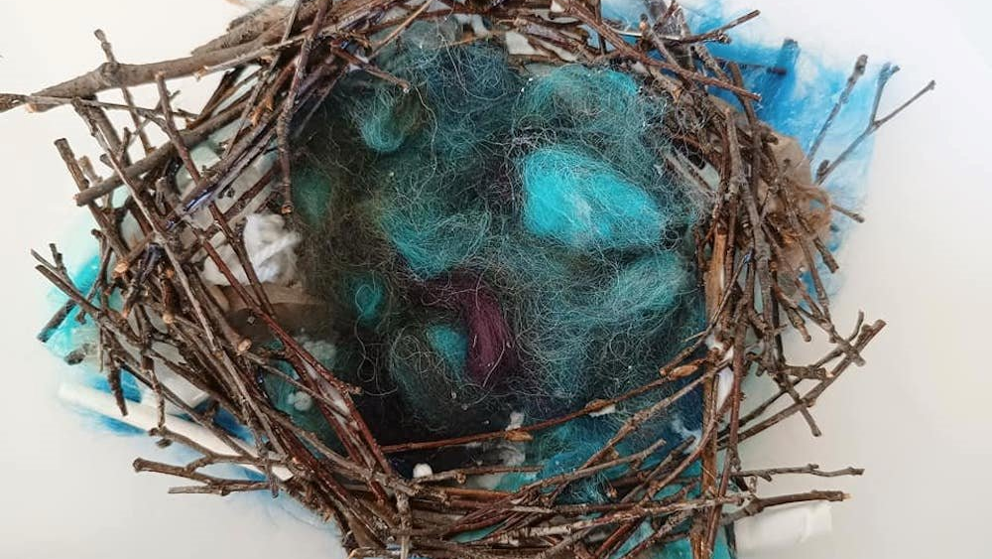
Next Steps…
Sign up for a free twilight CPD session.
Join the AccessArt Network Group to be kept up to date with news and events.
Explore our Galleries to see how other schools have been getting on with the curriculum.
Explore our FAQ page and Get in touch with any questions.

